Slide 1
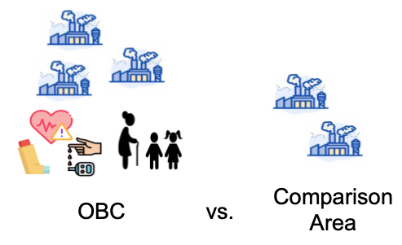
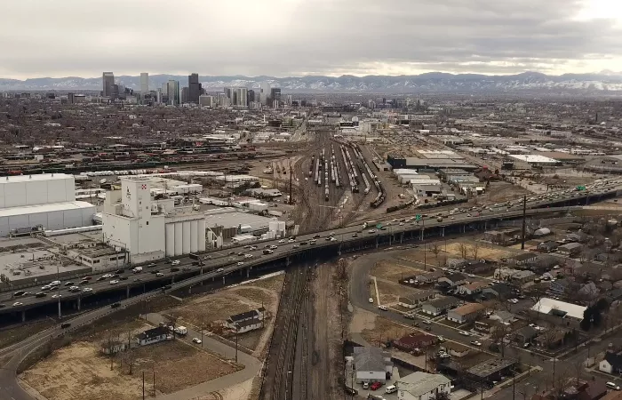
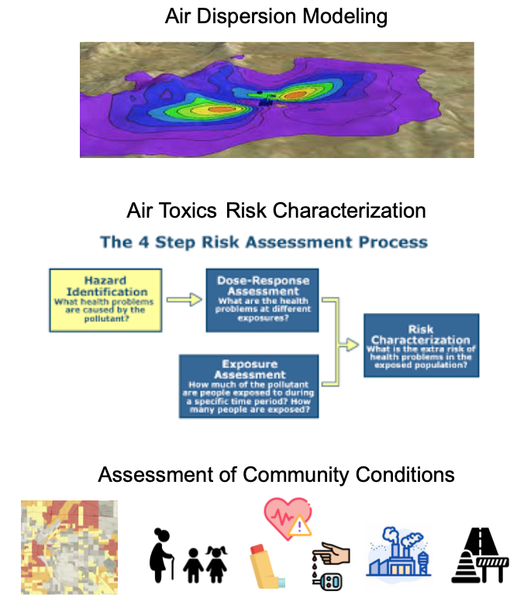
Cumulative Impact Analysis in State-Level Air Quality Policy with Recommendations for Colorado
Stephanie Pease, MPH Candidate; Collin Tomb, Boulder County OSCAR; Dr. Katherine Dickinson, Colorado SPH
NAAQS Inequities
Cumulative Impacts Approaches
General CIA Policy Recommendations
Current NAAQS are based on outdated single pollutant science, rely on self-reported data, and focus on facility type, not community conditions. Some pollutants have no safe level, actual exposures occur as mixtures that may have synergistic health impacts, and current air quality conditions are disproportionately worse in communities with high vulnerabilities, including areas impacted by the downstream impacts of redlining.
New Jersey CIA Approach
8 Facility types with air, water and soil impacts
Includes major sources of air pollution
Stressor comparison
Number of “stressors” are totaled for a particular EJ community, then compared to a “geographic point of comparison”
New facilities will be denied if stressor total is too high, existing facilities will be subject to binding conditions
Pros: Funded by permit applicants, sidesteps shortcomings of current NAAQS
Cons: Not a traditional CIA
Center EJ voices/perspective
Open communication with Advocates & EJ Communities
Avoid Injustice Olympics
Multi-media authority & Multi-agency cooperation
Air/Water/Soil linked
Define terms: Cumulative Impacts, DIC/EJ Priority Community, Indicator/Stressor
Recognize and circumvent limits of current science
CO policies must address inequities in air quality by requiring analysis of total community exposures and population vulnerabilities in permitting decisions that impact air, water, soil, etc. This approach is known as cumulative impact analysis (CIA).
CIA relevant CO policies
EJATF Recommendations
COGCC cumulative impacts rulemakings
GEMM2 rulemakings
Air Toxics legislation
Future legislative action
Definition of cumulative impacts
Multi-agency authority and cooperation over air/water/soil
Massachusetts CIA Approach
Air permits ONLY (based on distance to facility)
3-part CIA
Air Dispersion Modeling of Criteria Air Pollutants
Air Toxics Modeling and Risk Characterization
Qualitative Assessment of Existing Community Characteristics
Permits will be denied based on Quantitative results, may be denied based on Qualitative assessment.
Pros: Funded by permit applicants, quantitative basis for refusals
Cons: Relies on current NAAQS
Objective & Methods
To make recommendations for how to incorporate CIA into Colorado regulatory policy based on a comparative policy analysis of state-level CIA policies. Methods include a literature review & semi-structured interviews of regulatory officials, advocates, and academics within and outside of CO.
NAAQS: National Ambient Air Quality Standards
CIA: Cumulative Impact Analysis
EJ: Environmental Justice
EJATF: Environmental Justice Action Task Force
COGCC: Colorado Oil and Gas Conservation Commission
GEMM2: Greenhouse Gas Emissions and Energy Management for Manufacturing in CO

Slide 2



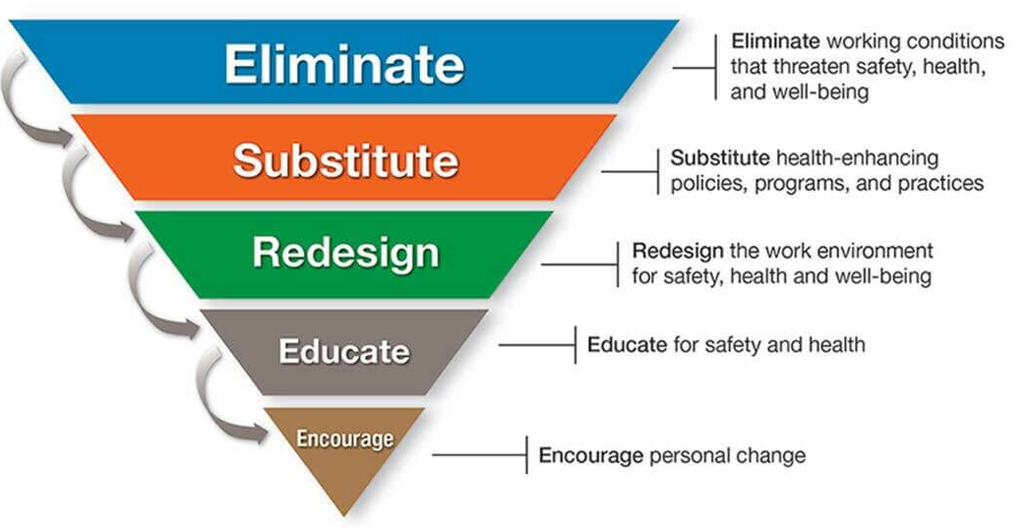
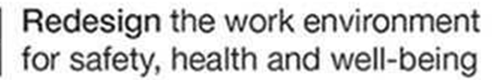
Employee Health and Wellbeing:
The impact of staff supportive physical work environments
Cedra Goldman, AIA, MPH, DrPHc
Advisor: Dr. Mike VanDyke, Colorado School of Public Health
Background and Objective
Methods and Results
Discussion and Next Steps
The current labor shortage is a public health issue. Some of the most impacted industry sectors are those with high-stress work environments, high rates of injury/illness, and employee populations that are un-desked.
As part of a holistic Total Worker Health® approach to addressing the issue of labor shortages, it is important to look at factors that impact employee health and wellbeing in order to identify intervention strategies that can reduce employee burnout and quit rates.
We completed a literature review that was cross-disciplinary and included sources from the fields of architecture/design, occupational health, medical science, and psychology. The review included academic studies, industry studies, expert commentaries, and established healthy-building rating standards.
Restoration
Socialization
Inclusivity
Supportive Physical Work Environments can provide areas of refuge from high-stress work environments, foster stronger employee relationships, contribute to employees engaging in self-care practices and mindful eating, and demonstrate to employees that their health and well-being is a priority to their employers.
A variety of space types can be used to provide supportive PWEs including breakrooms, lactation rooms, respite rooms, outdoor garden areas, privacy pods, prayer rooms, and restrooms.
Additional research on PWE interventions to mitigate the levels of burnout experienced by un-desked employee populations is needed.
An often-overlooked area of TWH-based intervention is physical work environments (PWEs). We sought to characterize evidence-based supportive PWE strategies to understand how they could be used to improve employee wellbeing and reduce burnout among workers in industries with historic staffing shortages.
“With workers in America today spending more than one-third of their day on the job, employers are in a unique position to promote the health and safety of their employees.”-CDC
Negative workplace-based health outcomes can be mitigated by implementing specific PWE strategies that have been shown to be supportive of health and wellbeing.
Citations
Allen, J. G., & Macomber, J. D. (2022). Healthy Buildings: How Indoor Spaces Can Make You Sick—or Keep You Well. Harvard University Press.
Andreucci, M. B. Loder, A. Brown, M. & Brajković, J. (2021). Exploring Challenges and Opportunities of Biophilic Urban Design: Evidence from Research and Experimentation. Sustainability, 13(8), 4323. https://doi.org/10.3390/su13084323
Bohle, P., Quinlan, M., Kennedy, D., & Williamson, A. (2004). Working hours, work-life conflict and health in precarious and" permanent" employment. Revista de saúde pública, 19-25
Boubekri, M. Cheung, IN. Reid, KJ. Wang, C-H. Zee, PC. (2014) Impact of Windows and Daylight Exposure on Overall Health and Sleep Quality of Office Workers: A Case-Control Pilot Study. Journal of Clinical Sleep Medicine. 2014;10(6):603-11. doi:10.5664/jcsm.3780
Burton, J., & World Health Organization. (2010). WHO healthy workplace framework and model: Background and supporting literature and practices. World Health Organization.
CDC NIOSH. Issues Relevant to Advancing Worker Well-Being Using Total Worker Health® Approaches. 2020.
Chari R, Chang C-C, Sauter SL, et al. Expanding the paradigm of occupational safety and health a new framework for worker well-being. Journal of occupational and environmental medicine. 2018;60(7):589.
Fergusen, Setphanie. (2023) Understanding America’s Labor Shortage: The Most Impacted Industries. US Chamber of Commerce. March 23, 2023, https://www.uschamber.com/workforce/understanding-americas-labor-shortage-the-most-impacted-industries.
Forooraghi M, Miedema E, Ryd N, Wallbaum H. How Does Office Design Support Employees’ Health? A Case Study on the Relationships among Employees’ Perceptions of the Office Environment, Their Sense of Coherence and Office Design. International Journal of Environmental Research and Public Health. 2021;18(23):12779.
Grawitch MJ, Gottschalk M, Munz DC. The path to a healthy workplace: A critical review linking healthy workplace practices, employee well-being, and organizational improvements. Consulting Psychology Journal: Practice and Research. 2006;58(3):129.
Griffeth RW, Hom PW, Gaertner S. A meta-analysis of antecedents and correlates of employee turnover: Update, moderator tests, and research implications for the next millennium. Journal of management. 2000;26(3):463-488.
Halldorsson, F., Kristinsson, K., Gudmundsdottir, S., & Hardardottir, L. (2021). Implementing an activity-based work environment: A longitudinal view of the effects on privacy and psychological ownership. Journal of Environmental Psychology, 78, 101707.
Horrigan, M., Heggeness, M., Bahn, K., & Strain, M. R. (2022). Is there a labor shortage?. Business Economics, 57(1), 6-22.
International Well Building Institute (IWBI). WELL, v2: the next version of the WELL Building Standard. 2020.
Kamaruzzaman, S. N. Sabrani, N. A. (2011). The effect of indoor air quality (IAQ) towards occupants’ psychological performance in office buildings. Journal Design+ Built, 4(1), 49-61.
Kerr, M., & Norman, R. (2003). Risk factors for musculoskeletal injury at work. In Preventing and managing disabling injury at work (pp. 13-32). Taylor & Francis New York.
Kim, J., Candido, C., Thomas, L., & de Dear, R. (2016). Desk ownership in the workplace: The effect of non-territorial working on employee workplace satisfaction, perceived productivity and health. Building and Environment, 103, 203-214.
Kurniawaty, K., Ramly, M., & Ramlawati, R. (2019). The effect of work environment, stress, and job satisfaction on employee turnover intention. Management science letters, 9(6), 877-886.
Kwon M, Remøy H, van den Dobbelsteen A, Knaack U. Personal control and environmental user satisfaction in office buildings: Results of case studies in the Netherlands. Building and environment. 2019;149:428-435. doi:10.1016/j.buildenv.2018.12.021
Lee SY, Brand JL. Effects of control over office workspace on perceptions of the work environment and work outcomes. Journal of environmental psychology. 2005;25(3):323-333. doi:10.1016/j.jenvp.2005.08.001
Lusa S, Kapykangas SM, Ansio H, Houni P, Uitti J. Employee Satisfaction With Working Space and Its Association With Well-Being-A Cross-Sectional Study in a Multi-Space Office. Front Public Health. 2019;7:358. doi:10.3389/fpubh.2019.00358
Moss, J. (2021). The burnout epidemic: The rise of chronic stress and how we can fix it. Harvard Business Press.
Nejati A, Rodiek S, Shepley M. The implications of high-quality staff break areas for nurses' health, performance, job satisfaction and retention. J Nurs Manag. May 2016;24(4):512-23. doi:10.1111/jonm.12351
Olson R, Wright RR, Elliot DL, et al. The COMPASS Pilot Study: A Total Worker Health™ Intervention for Home Care Workers. Journal of occupational and environmental medicine. 2015;57(4):406-416. doi:10.1097/JOM.0000000000000374
Özkan, A. H. The effect of burnout and its dimensions on turnover intention among nurses: A meta‐analytic review. Journal of Nursing Management, 30(3), 660-669.
Passchier-Vermeer, W. Passchier, W. F. (2000). Noise exposure and public health. Environmental health perspectives, 108(suppl 1), 123-131.
Perales F, Ablaza C, Elkin N. Exposure to Inclusive Language and Well-Being at Work Among Transgender Employees in Australia, 2020. American journal of public health (1971). 2022;112(3):482-490. doi:10.2105/AJPH.2021.306602
Putrino, D. Ripp, J. Herrera, J. E. Cortes, M. Kellner, C. Rizk, D. Dams-O'Connor, K. (2020). Multisensory, Nature-Inspired Recharge Rooms Yield Short-Term Reductions in Perceived Stress Among Frontline Healthcare Workers. Frontiers in psychology, 11, 560833. https://doi.org/10.3389/fpsyg.2020.560833
Schneider, D., & Harknett, K. (2019). Consequences of routine work-schedule instability for worker health and well-being. American Sociological Review, 84(1), 82-114.
Shore, L. M., Cleveland, J. N., & Sanchez, D. (2018). Inclusive workplaces: A review and model. Human Resource Management Review, 28(2), 176-189.
U.S. Bureau of Labor Statistics (BLS). News Release: Job Opening and Labor Turnover-January 2023. March 8, 2023.
U.S. Bureau of Labor Statistics (BLS). Incidence rates of nonfatal occupational injuries and illnesses by industry and case types, 2022. https://www.bls.gov/web/osh/summ1_00.htm
US Green Building Council (USGCB). LEED v4 for BUILDING DESIGN AND CONSTRUCTION. v4 ed2019.
van Dellen, S.A. Wisse, B. Mobach, M.P. et al. (2021). A cross-sectional study of lactation room quality and Dutch working mothers’ satisfaction, perceived ease of, and perceived support for breast milk expression at work. Int Breastfeed J 16, 67 (2021). https://doi.org/10.1186/s13006-021-00415-y
Wright TA, Huang CC. The many benefits of employee well‐being in organizational research. Journal of Organizational Behavior. 2012;33(8):1188-1192.
Image Credits:
Lee, M. P., Hudson, H., Richards, R., Chang, C. C., Chosewood, L. C., & Schill, A. L. (2016). Fundamentals of total worker health approaches: essential elements for advancing worker safety, health, and well-being.
https://www.express.co.uk/life-style/property/1546600/work-from-home-houseplants-productivity-evg
https://www.istockphoto.com/search/2/image?phrase=office+break+room
https://www.mydoorsign.com/blog/gender-inclusive-restroom-signs-for-transgender-citizens/

Slide 3

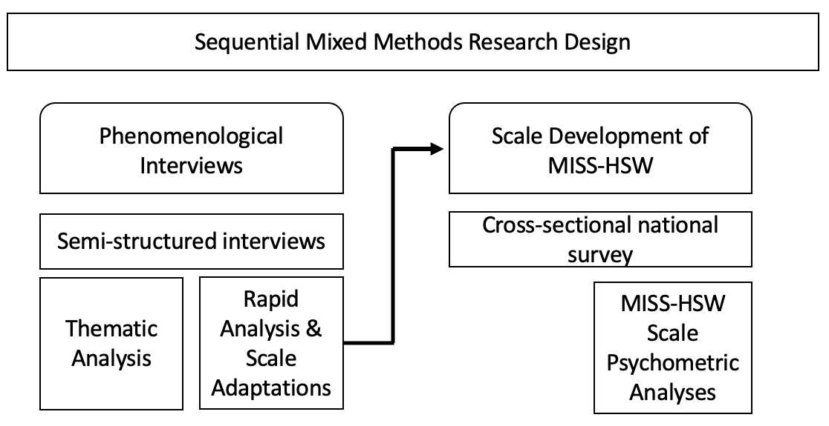
Measuring Moral Injury Amongst Healthcare Social Workers: A Mixed Methods Scale Development Study
Pari Shah Thibodeau, MSW, LCSW, PhD Candidate, Graduate School of Social Work, University of Denver
Background
Methods
Measure | M (S.D.)
Moral Injury Symptom Scale- Healthcare Social Work | 55.39 (17.19)
Moral Injury Symptom Scale- Health Professionals | 37.75 (14.15)
Life Events Checklist – 5 (LEC-5)
Primary Trauma Exposure from Happening to Me | 2.95 (2.41)
Primary Trauma Exposure from Witnessing | 2.77 (2.89)
Secondary Trauma Exposure from Learning | 6.56 (5.41)
Work-Related Exposure | 6.59 (5.43)
Maslach’s Burnout Inventory (MBI)
Emotional Exhaustion | 28.28 (11.45)
Depersonalization | 8.79 (5.90)
Personal Accomplishment | 36.02 (6.04)
Patient Health Questionnaire – 9 (PHQ-9) | 5.65 (4.71)
Generalized Anxiety Disorder – 7 (GAD-7) | 6.12 (5.00)
These past few years, frontline medical workers have been under pressure to treat the coronavirus (COVID-19) pandemic, while mental health workers have responded to a parallel, yet invisible, mental health crisis. These workers already inhabit high stress work environments with limited resources, a combination which leads to adverse outcomes, such as burnout, poor job satisfaction and retention, and mental health symptoms and diagnoses (Ritchie, 2019; National Academies of Medicine, 2019). In short, research has demonstrated that our healthcare workers are not doing well (Vagni et al., 2020; Dean et al., 2020). Increasingly the role of clinical social workers on healthcare teams (i.e., healthcare social workers [HSWs]) is central to the implementation of patient services; social workers are considered the glue on many interdisciplinary teams, as they are trained to actively listen, build rapport, and work within complex systems (Craig & Muskat, 2013).
The pandemic introduced complex moral situations for the healthcare industry to navigate, including HSWs in their roles. Moral injury is an innovative indicator of the health and well-being of the HSW workforce. Moral injury is defined as, the moral transgression (or boundary breaking) by oneself or someone in a position of power in high stakes situations and the negative outcomes of those experiences (Litz & Kerig, 2019; Shay, 2014). A scale exists to measure moral injury amongst healthcare workers, primarily doctors and nurses; Moral Injury Symptom Scale- Healthcare Provider (MISS-HP).
This study used a sequential mixed methodological approach with five phases of data collection and analysis. First, qualitative semi-structured interviews were conducted with exploratory questions (part 1) and structured questions (part 2). Second, thematic qualitative analysis was conducted on the exploratory questions. Third, rapid analysis was conducted on the structured scale related questions. Fourth, a national cross-sectional survey was administered. Fifth, descriptive and psychometric statistical analyses were conducted.
Implications
HSWs have essential roles in healthcare
HSWs need to be better supported and retained
Moral injury is a serious condition that needs to be addressed.
MISS-HSW is more internally consistent than MISS-HP
MISS-HSW can be used to self assess and intervene on well-being.
Moral injury and well-being interventions are necessary.
HSW integration on teams is beneficial.
Resource scarcity needs to be addressed at the policy-level.
Objectives
Findings
Aim 1 explores the phenomenon of moral injury amongst HSWs to provide a holistic understanding on how HSWs’ experiences are impacted by moral injury. Phenomenological qualitative interviews are utilized to explore moral injury amongst HSWs. Additionally, specific questions are asked regarding development of a moral injury scale for HSWs.
Aim 2 adapts the MISS-HP to better reflect the experiences of moral injury amongst HSWs, creating a new scale, the Moral Injury Symptom Scale-Healthcare Social Work (MISS-HSW), which is tested nationally. Additional professional and personal well-being scales are administered to study the relationship between moral injury, burnout, and mental health functioning.
Qualitative Findings | Quantitative Results
N = 24 | N = 158
Majority white, cis-female, hospital social workers. | Majority white, cis-female, hospital social workers
3 Themes (see figure right) | MISS-HSW alpha = 0.86
 | 2 Factors Produced (emotions factor, purpose/values factor)
 | HSWs are experiencing adverse wellbeing
HSW Definition & Characteristics of Moral Injury
HSW as the “in between” or policy & practice
Upholding social work values in healthcare
1
2
3

Slide 4
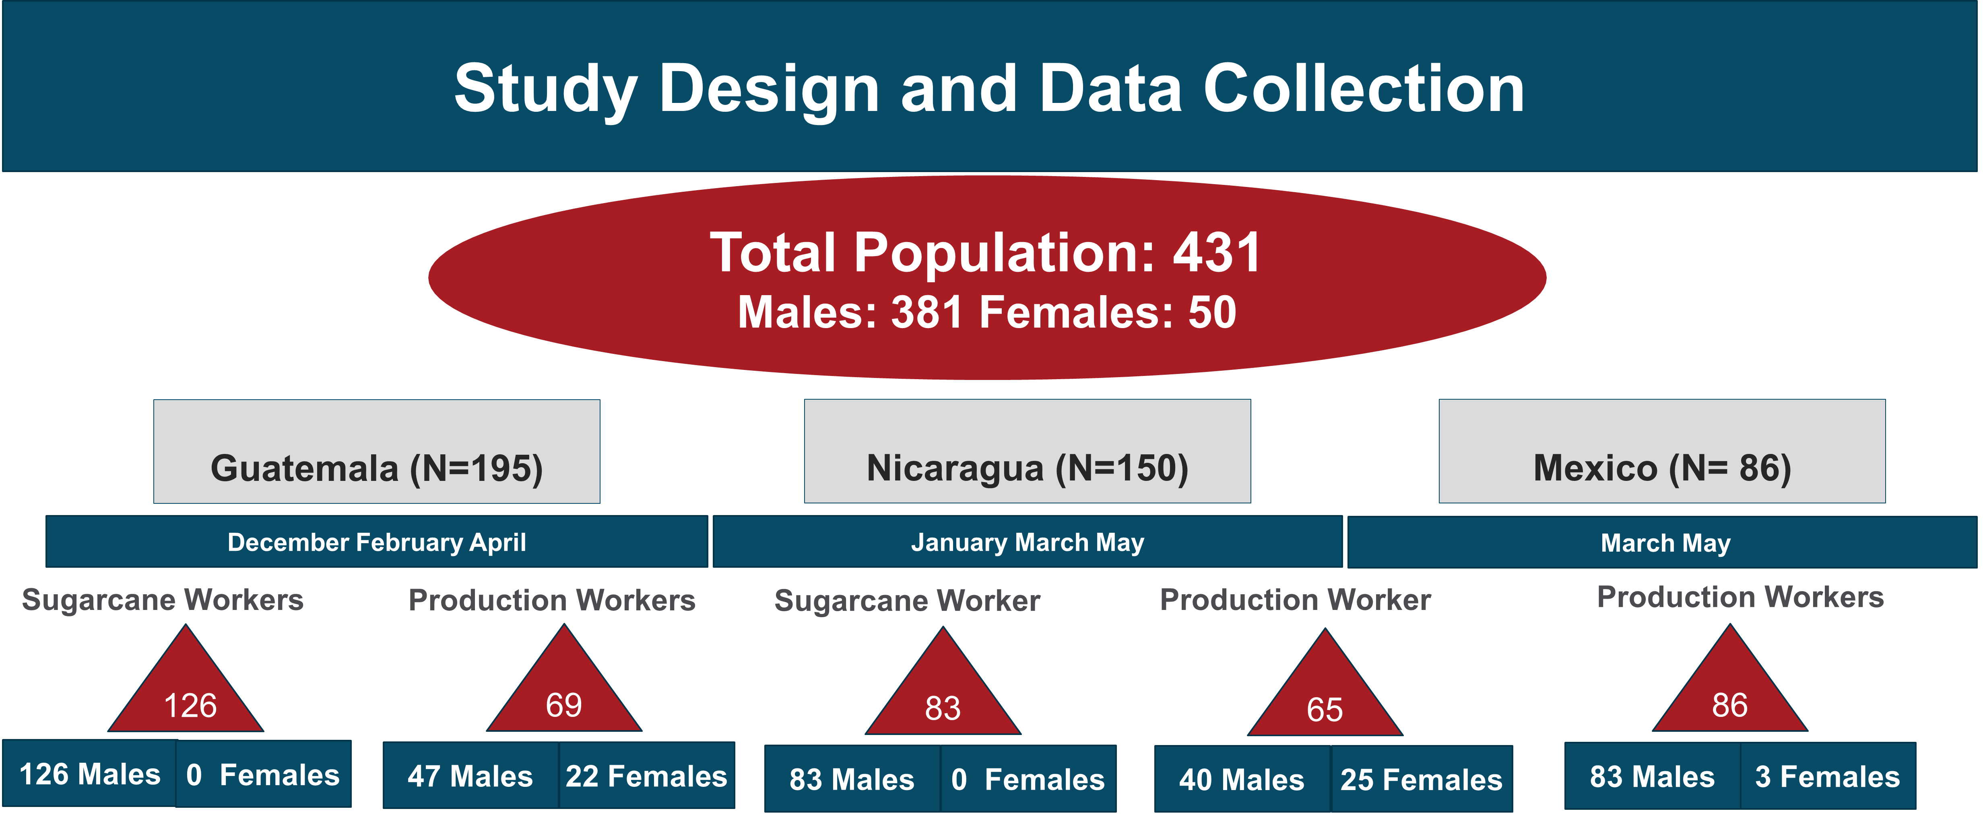
Risk Factors for Kidney Injury Among Male and Female Sugarcane Workers in Central America
Sara Hull, MPH Candidate EHOH and Epidemiology
Preceptor: Dr. Jaime Butler-Dawson
Background
Results
Agricultural workers in Central America, such as sugarcane and production workers in Guatemala, Nicaragua, and Mexico are at an increased risk of developing Chronic Kidney Disease of Unknown Cause (CKDu). CKDu it is thought to have a multifactorial etiology, and several mechanisms have been proposed including; exposure to agrochemicals, heavy metals, and NSAIDS. Many of these exposures may play a role in developing CKDu, however, the current leading hypothesis is that strenuous physical labor in in hot climates may lead to recurrent heat stress and dehydration, which may result in an increased risk of acute kidney injury (AKI), and reduced kidney function over time. Many previous studies have focused on male workers; however, female workers may also be at risk of CKDu.
Summary
Objectives
Female workers were at a significant increased risk of kidney injury across the work shift and there was trending significance among all production workers
Among all workers, decreases in hydration markers were associated with kidney injury
Younger workers were at an increased risk of kidney injury
Those with prediabetes (n=46) or diabetes (n=3) were more likely to be dehydrated at the beginning of the work shift
Females were more likely to be hydrated at the beginning of the work shift but were at an increased risk of dehydration at the end of the workday
This study examined hydration status and kidney function across the work shift among 431 male and female sugarcane workers in Guatemala, Nicaragua, and Mexico.
Aim 1: Investigate biomarkers associated with change in creatinine (kidney injury) in male & female sugarcane workers
Aim 2: Investigate risk factors for pre- and post-shift dehydration in male & female sugarcane workers
Methods
Bivariate analysis of demographics, pre- & post-shift biomarkers, and change in creatinine across work shift
Model selection for multivariable models based on bivariate analysis: borderline significant variables (p-value <0.1) and potential confounders were included in the final models
Multivariable models: 1) pre & post-shift biomarkers and change and creatinine, 2) risk factors and dehydration
Recommendations
Work with sugarcane agribusiness to educate women and production workers on the importance of rest, shade, and hydration
Reduce barriers to hydration for women and production workers
Increase access to water and electrolytes packets in the field
Notes:
Background:
Agricultural workers in Central America such as sugarcane and production workers are at in increased risk of chronic kidney disease of unknown cause, CKDu is distinct as it is not associated with traditional risk factors such as age, diabetes, or hypertension,
and is of particular importance to public health as it effects otherwise healthy young workers and often occurs in regions were access to treatment is limited.
The cause of the disease is unknown; however, the current leading hypothesis is that strenuous physical labor in in hot climates may lead to recurrent heat stress and dehydration, which may result in an increased risk of acute kidney injury (AKI), and reduced kidney function over time. Many previous studies have focused on male workers; however, female workers may also be at risk.
Objective
The purpose of this study was to investigate biomarkers associated with change in creatinine (a marker of kidney function) and risk factors for pre and post shift dehydration in male and female sugarcane workers.
Methods:
The Center for health work and environment has been working with a sugarcane producer in central America to implement a total worker health and hydration program. To prevent dehydration, workers are given water and electrolyte packets and encouraged to drink between 5 to 10 L and continue to hydrate after the work shift. Data collected for this study are part of the health surveillance initiative and include information on demographics, and biomarkers such as serum electrolytes, specific gravity, a marker of dehydration, and serum Creatinine, a marker of kidney injury. Pre and post shift data were collected from a total of 431 workers including 381 males and 50 females across Guatemala, Nicaragua, and Mexico.
The methods for this analysis include
Bivariate analyses, of the association between pre and post shift biomarkers and change in creatinine across work shift as well as dehydration.
based on the results from the bivariate analysis, borderline significant variables (p-value <0.1) and potential confounders were included in final multivariable models to look at change in creatinine and the odds of dehydration pre and post shift.
Results
So what I found was that
Female workers were more likely to have kidney injury across the work shift compared to males and there was trending significance of kidney injury among production workers compared to sugarcane workers
Among all workers, decreases in hydration markers were associated with kidney injury
Younger workers were at an increased risk of kidney injury across the work shift.
Those with prediabetes (n=46) or diabetes (n=3) were more likely to be dehydrated at the beginning of the workday (which may indicate they are not hydrating properly after work)
Females were more likely to be hydrated at the beginning of the work shift but were at an increased risk of dehydration by the end of the day, indicating that there may be barriers to staying hydrated during the workday.
Based on these results my recommendations are to
Work with sugarcane producer to educate women and production workers on the importance of rest, shade, and hydration.
Reduce barriers to hydration for women and production workers in the field.
Increase access to water and electrolytes packets.

Slide 5
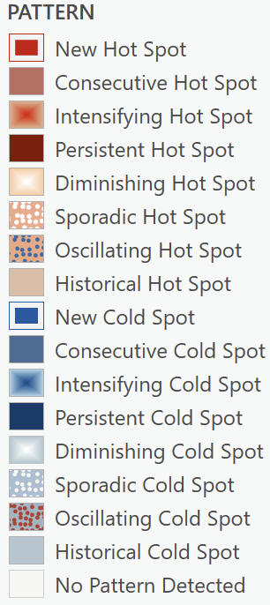
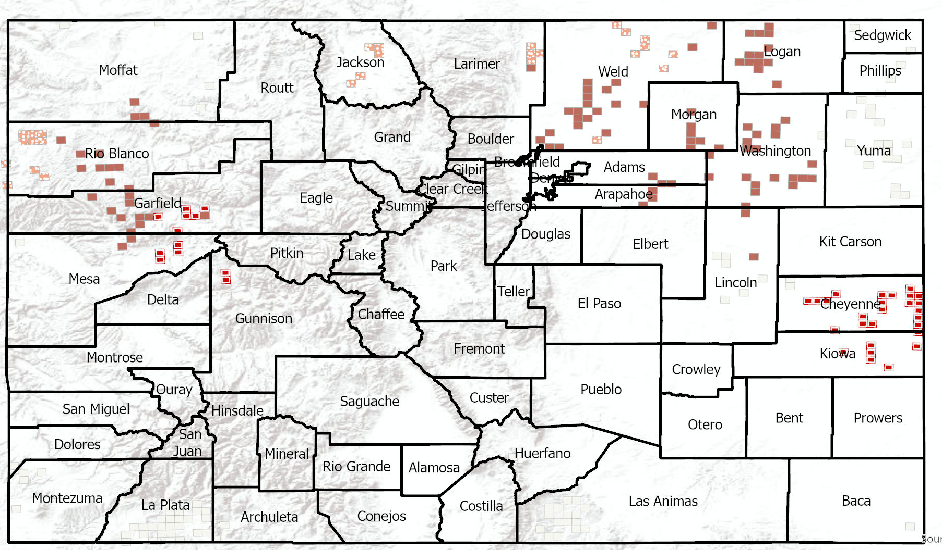
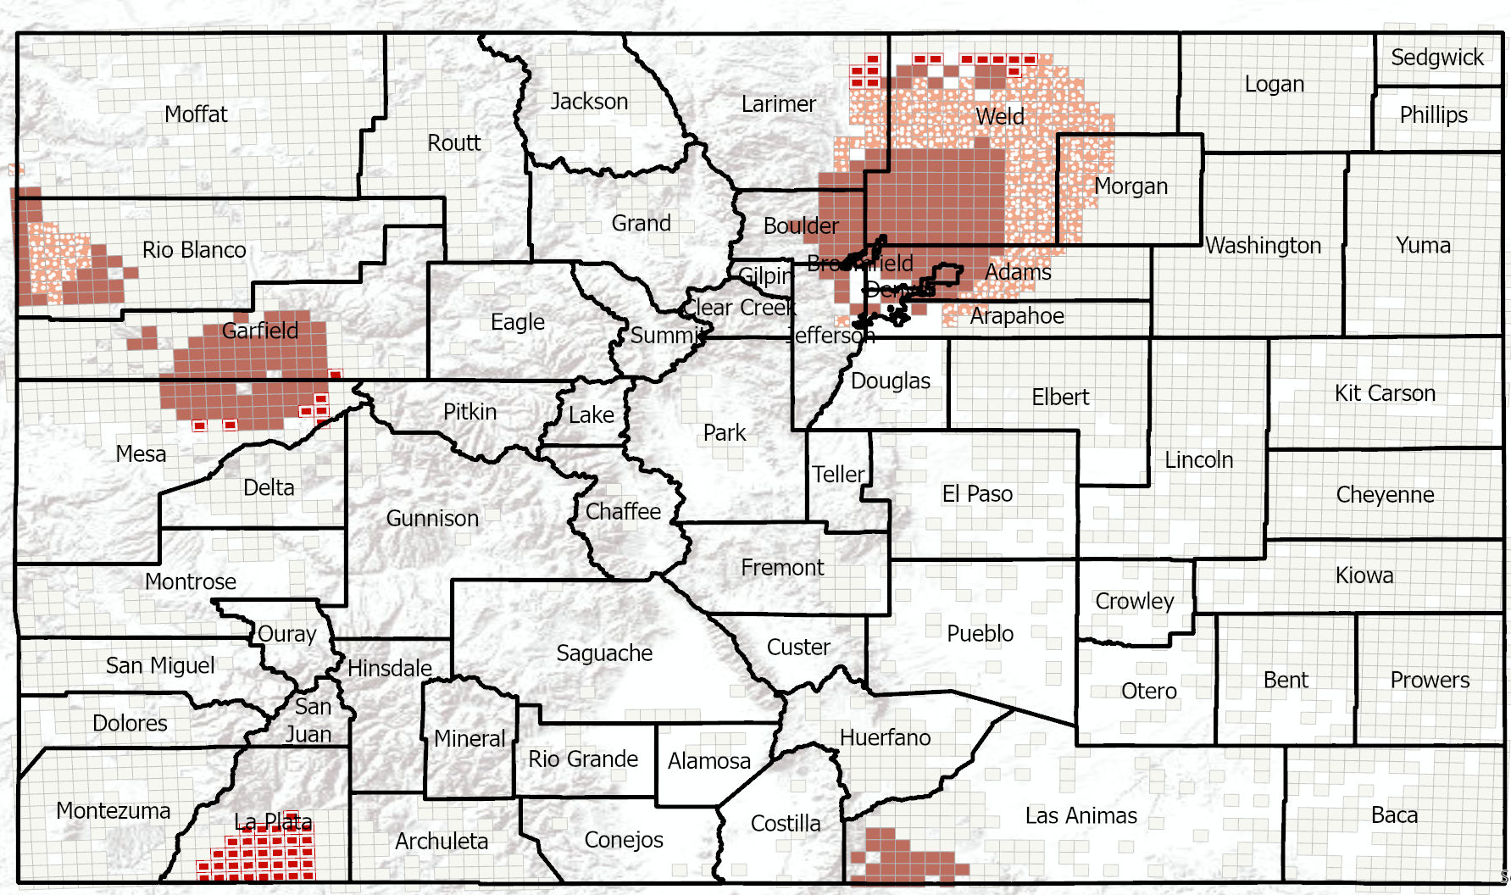
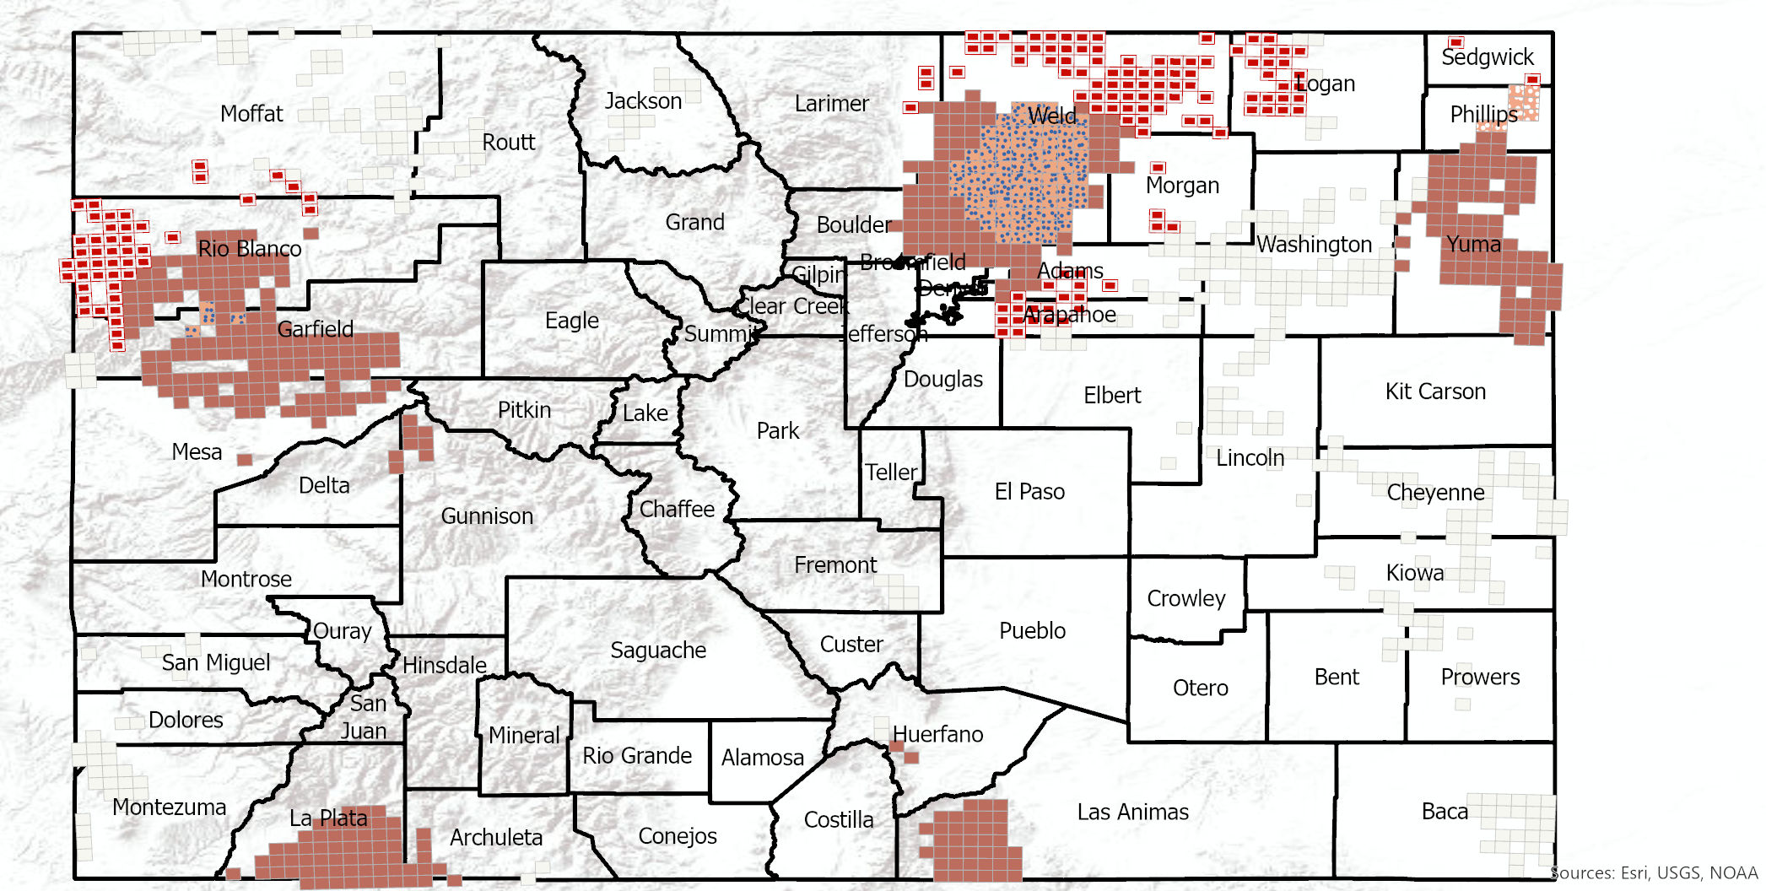
Spatiotemporal Patterns of Injection & Abandoned Oil & Gas Wells in Colorado
Hannah L. Walters, MPH | DrPH Student, EOH, Colorado School of Public Health
Background & Objectives
Results
In the last ten years, oil and gas (OG) production in Colorado has quadrupled due to innovations in extractive technology. Research on decommissioned oil and gas infrastructure will become increasingly important as the U.S. transitions away from fossil fuels. Understanding patterns of inactive wells now and which communities may be disproportionately burdened by aging infrastructure, would help illuminate the full lifecycle of risk that communities face while OG companies continue to seek new well construction.
This analysis sought to characterizes the spatial landscape of abandoned/repurposed oil and gas infrastructure in the state, while setting up future research questions related to the environmental justice, and potential health risks associated with abandoned oil and gas wells in Colorado.
There were unsurprising consecutive hotspots of all well types in Weld and Garfield counties. Of note was new emerging hotspot of injection wells in Cheyenne county and of abandoned wells in La Plata. There were no historical or diminishing hotspots of any well type, only an oscillating hotspot of producing wells in Weld and Garfield. Sample sizes of respondents to TABS who live within 1 mile of abandoned or injection wells was too small to test for statistical differences and reporting.
Injection Wells
Abandoned
Methods
Producing
Study Area/Population: Colorado, respondents to the 2022 TABS survey.
Data Sources:
2021 Colorado Oil & Gas Conservation Commission (COGCC)
2022 The Attitudes & Behavior Survey (TABS)
Geospatial Analyses:
Emerging hotspot analysis of injection, abandoned, producing, and permitted wells.
Near distances between TABS respondent residential locations and abandoned and injection wells were calculated to classify proximity.
Top 5 Counties by Well Type, 2021 |  | Top 5 Counties by Well Type
Injection |  | Abandoned |  | Producing
County | Count | County | Count | County | Count
Rio Blanco | 293 | Weld | 16,593 | Garfield | 11,140
Weld | 53 | Washington | 5,091 | Weld | 11,024
Garfield | 44 | Logan | 3,689 | Yuma | 3,535
Cheyenne | 36 | Adams | 2,980 | La Plata | 2,789
Jackson | 36 | Rio Blanco | 2,851 | Las Animas | 2,515
Next Steps
Gauge community concern around oil and gas well decommissioning and potential hazards from aging OG wells. Explore other data sources or pursue primary data collection tailored to understand sociodemographic patterns and residential proximity to injection and abandoned wells.

Slide 6


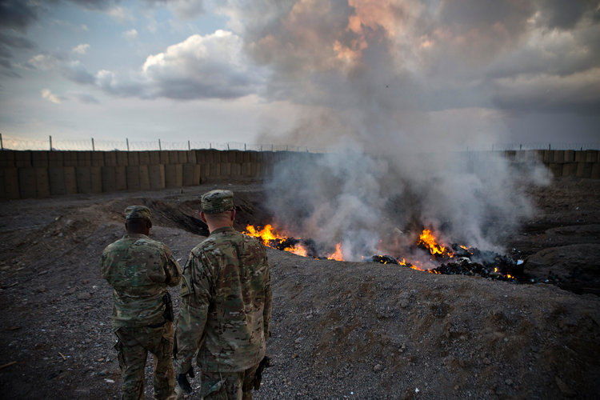
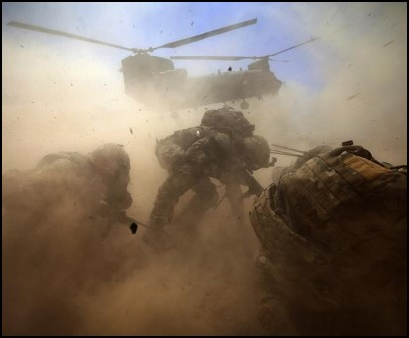
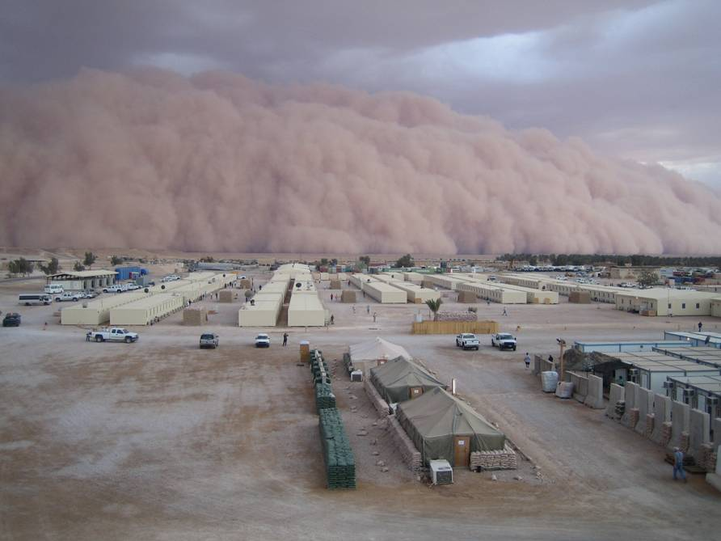
Changes in lung function after deployment to Southwest Asia among military personnel with respiratory symptoms
Lauren Zell-Baran^{1,2} (zell-baranl@njhealth.org ); Silpa Krefft^{1,2,3}; Matthew Strand^{1,2}; Cecile Rose^{1,2}
1. National Jewish Health 2. University of Colorado 3. Rocky Mountain Regional VA Medical Center
Background
Methods
Results
Military deployment to Southwest Asia (SWA) is associated with exposure to inhalational hazards:
Burn pit combustion products
Sandstorms
Diesel exhaust
Combat dusts and improvised explosive device (IED) blasts
Post-9/11 deployment can cause deployment-related respiratory diseases (DRRDs). Little is known about risk factors for and the natural history of these diseases.
Study subjects were SWA-deployed veterans who underwent occupational lung disease evaluation at National Jewish Health between 2009 and 2022 (n=230).
Analyzed all available spirometry tests that met American Thoracic Society quality criteria.
Compared differences between subjects’ cumulative exposures (grouped by tertile) and DRRDs using a linear mixed model. Models included a random intercept for each subject, group x time interactions, and a spatial power covariance structure in SAS.v.9.4.
Potential covariates were selected based on a theoretical model and associations with exposures and/or outcomes in our dataset.
Adjusting for smoking and family history of asthma, mean [95% CI] FEV1pp was significantly different between inhalational exposure groups (p=0.004).
  Highest tertile: 88.8% [84.4%, 93.2%]
  Lowest tertile: 97.2% [93.2%, 101.2%]
Both mean FEV1pp and annual changes in FEV1pp were significantly different between diagnosis groups (Table 2). Annual changes suggest no accelerated declines in FEV1pp.
Results
Objective
Table 1: Characteristics of previously deployed participants with respiratory symptoms and one or more pulmonary function test (n=230)
Table 2: Pre-bronchodilator FEV1pp by diagnosis group* (n=174)
Examine if veterans with DRRDs have accelerated declines in lung function and if exposure hazards are linked to lung function.
Demographics
Male | 202 (88%)
Age at first test (years) | 39.9 ± 9.5
Ever smoked cigarettes | 82 (36%)
Smoking pack-years | 9.1 ± 13.0
Ever smoked other products^ | 33/156 (21%)
Deployment Information
Number of deployments, median (range) | 2 (1-11)
Total deployment duration (months), median (range) | 16 (2-143)
Deployment location
Iraq | 95 (41%)
Afghanistan | 45 (20%)
Both | 72 (31%)
Other | 18 (8%)
Reported exposure >1-2 times per week
Sandstorms | 42/208 (20%)
Burn pits | 170/213 (80%)
Diesel exhaust | 187/196 (95%)
Combat dust | 33/199 (17%)
Post-Deployment Spirometry
Number of tests, median (range) | 3 (1-18)
Duration of follow-up (months), [median (range)] | 16.5 ± 28.2 [4 (0-160)]
FEV1pp | 92.2 ± 15.5
FVCpp | 93.2 ± 13.5
FEV1/FVC | 80.0 ± 7.2
Change among those with >1 year follow-up (n=71) (%)
ΔFEV1pp | 3.3 ± 12.7
ΔFVCpp | 2.1 ± 11.7
ΔFEV1/FVC | 0.6 ± 5.1
Disease Group
Deployment-related asthma (DRA) | 29 (13%)
Deployment-related distal lung disease (DDLD) | 92 (40%)
Both DRA and DDLD | 54 (23%)
Other DRRDs* (or respiratory symptoms only) | 55 (24%)
Treated with asthma medications | 153/228 (67%)
Reported family history of asthma or emphysema | 34/174 (20%)
Diagnosis Group | Mean** [95% CI] | Mean Change per year
DDLD/DRA | 81.9 [76.7, 87.1]^{b,c,d} | 0.55 p=0.08
DRA only | 98.3 [91.6, 105]^{a,c} | 1.10 p=0.006
DDLD only | 93.7 [89.7, 97.7]^{a,b} | 0.09 p=0.63
Other DRRDs | 95.5 [89.7, 101.3]ª | 0.39 p=0.24
A
B
*Adjusted for smoking and family history of asthma
**Estimated five years after last deployment
Group comparisons: a=DDLD/DRA, b=DRA, c=DDLD, d=other
C
Recommendations
More intense inhalational exposures -- linked to lower post-deployment lung function – should be the focus of exposure control.
Future analyses are needed to explore other lung function parameters and their relation to respiratory symptom outcomes.
Longitudinal follow-up of patients with deployment-related respiratory diseases is essential to inform treatment and prevention efforts.
Note: All values are the mean (±SD) or n (%) unless otherwise indicated.
Abbreviations: FEV1 = forced expiratory volume in the first second; FVC = forced vital capacity; pp = percent predicted
^Other products includes cigars, a pipe, water pipe, e-cigarettes, or marijuana.
*Other DRRDs include rhinosinusitis, vocal cord dysfunction, and/or probable mitochondrial myopathy.
Figure 1. (A) US Army soldiers watch garbage burn in a burn pit at Forward Operating Base Azzizulah in Maiwand District, Kandahar, Province, Afghanistan, February 4, 2013. Source: REUTERS/Andrew Burton. (B) Helicopter generated dust. Source: www.thetimes.co.uk (C) Sandstorm in Al Asad, Iraq in 2007. Source: James Gordon.
This publication was supported by Grant Number T42OH009229 from CDC NIOSH Mountain and Plains Education and Research Center. Its contents are solely the responsibility of the authors and do not necessarily represent the official views of the CDC NIOSH and MAP ERC.

Slide 7
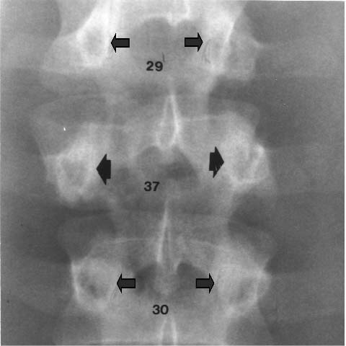
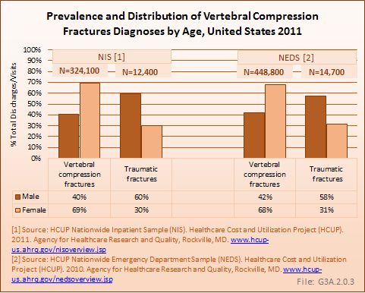
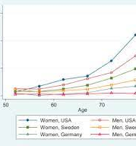
The Aging Workforce
Vertebral Compression Fractures & Clinical Imaging of Spinal Trauma
Judith Brutus-Lestin, MD
CU Occupational Medicine Residency Program, PGY- 2 Resident
Colorado School of Public Health
Radiographic Diagnosis
Background
Epidemiology
Plain X-ray films- Lateral View
There is loss of >20% vertebral body height seen in thoracic kyphosis.
Vertebral fracture through the posterior elements is usually present
Flexion and extension radiographs may also be useful in assessing spinal stability
Case Presentation:
68yo F librarian, otherwise healthy diagnosed with contusion of unspecified back wall of thorax secondary to fall while leaning backwards in a chair. Presented with no focal neurological deficit.
Classification of Vertebral Compression Fractures:
Biconcave (Codfish Vertebra)
Wedge Fracture
Compression Fracture (Vertebra Plana)
Vertebral Compression Fractures is the single greatest risk for future fractures at all other skeletal sites in untreated populations, including hip fractures.
A Norwegian population-based Tromso study found that 20.3% of men and 19.2% of women aged >70 years had at least 1 vertebra fracture.
Most common vertebrae affected: Approximately 50% in the Cervical Spine and 50% in the thoracic, lumbar & sacral spine.
Objectives
Specific Aim: To understand the effect of vertebral abnormalities from traumatic injuries in the aging workforce and the approach to clinical diagnostic imaging.
The burst fracture is a specific form of compression fracture of the vertebral body where a fragment arising from the posterior vertebral wall is displaced into the spinal canal. This determines whether the fracture is stable or unstable.
Burst fractures most commonly occur in L1 with the majority (90%) occurring from T9-L5.
The retropulsed fragment may result in neurological injury to the spinal cord, conus medullaris, or cauda equina. It is caused by severe axial compression forces exerted on the spine.
Conclusion/
The Aging Workforce
Currently, >12% of the employed civilian labor force in the United States is composed of individuals in their 60s and 70s.
There is a lack of awareness that vertebral compression fractures are asymptomatic.
Recommendations for primary screening are being developed to reduce mortality and morbidity caused by fragility fractures.

Slide 8
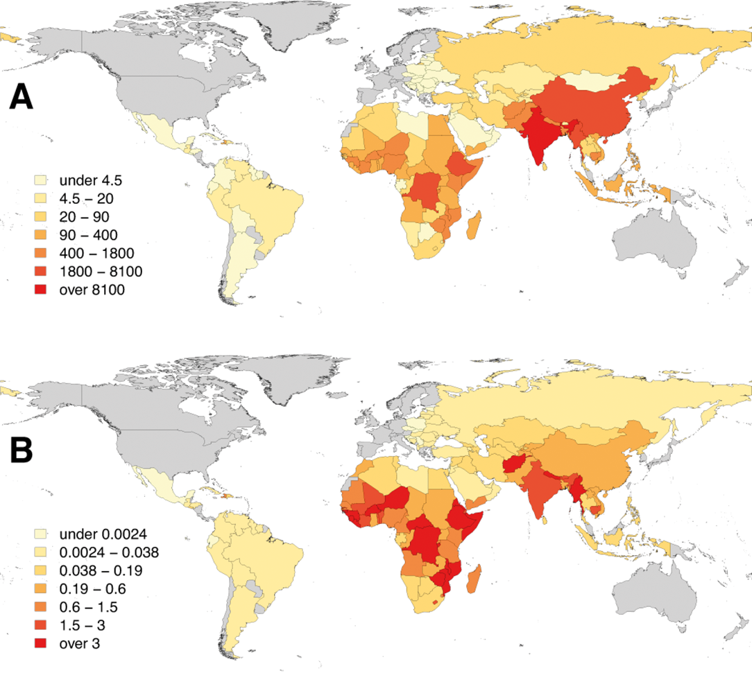
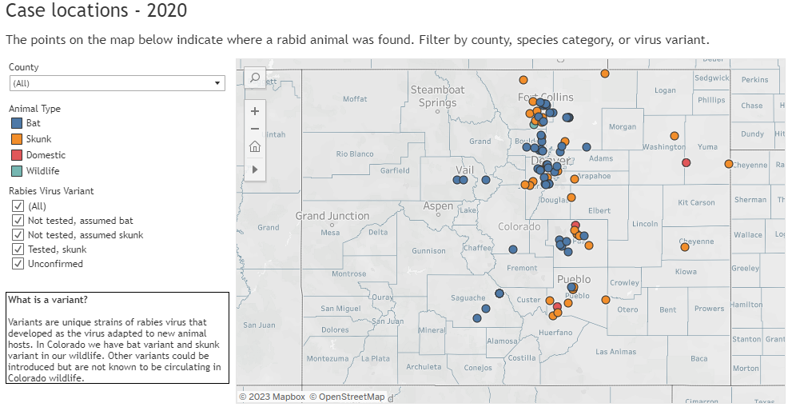
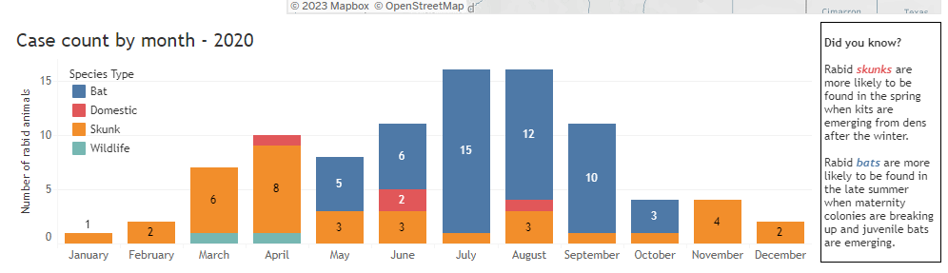
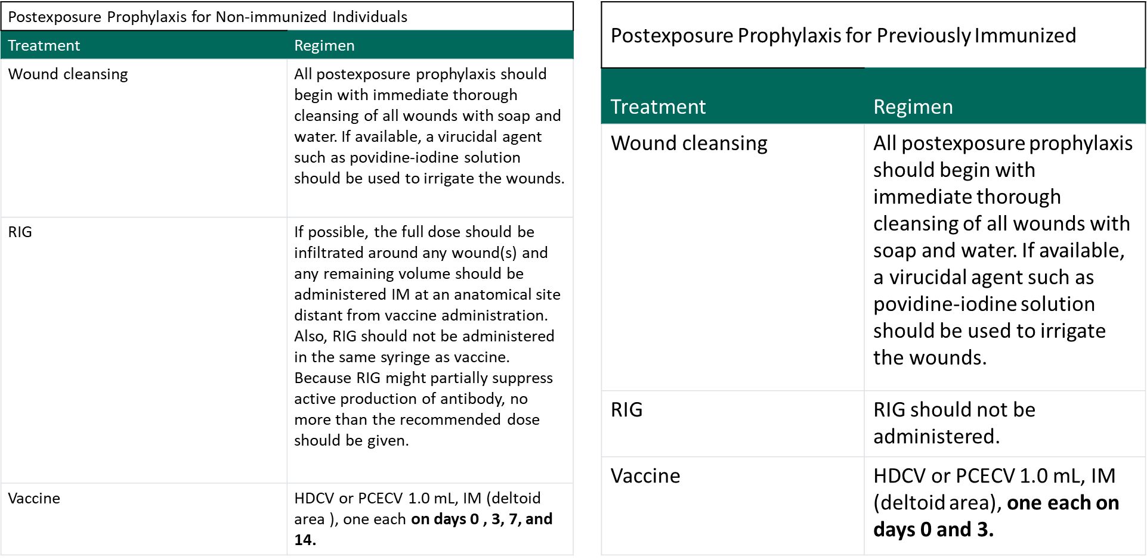
Animal Bites in the Workplace
Rachel Ain, MD MPH
PGY-2, Occupational & Environmental Medicine
University of Colorado
Background and Epidemiology
Animal bites can happen at work. When they occur, it is important to determine if the bite is reportable and report to the appropriate authorities. All animals that can transmit rabies are determined to be reportable bites.
Rabies is a preventable viral disease that is most often transmitted via the bite of a rabid animal (via the saliva). The viral zoonotic disease causes progressive fatal inflammation of the brain and spinal cord. Globally, and estimated 59, 000 human deaths/year in over 150 countries, with about 95% of those deaths occurring in Africa and Asia. 1. Per the CDC, “from 1960-2018, 127 human rabies cases were reported in the United States, with roughly a quarter of those resulting from dog bites received while traveling internationally. Of infections acquired in the United States, 70% were attributed to bat exposures.
1. https://www.who.int/activities/improving-data-on-rabies/rabies-epidemiology-and-burden
https://cdphe.colorado.gov/animal-related-diseases/rabies
Bitten at work? What next?
There are many different workers who can get an animal bite at work ranging from veterinarians to builders. The main concerns with all animal bites are infections such as tetanus, rabies, or staph/strep (among others).
Tetanus can be transmitted via a bite, so patients should be administered tetanus prophylaxis as soon as possible. If the patient has never had a tetanus vaccine before, tetanus immunoglobulin is needed up to 21 days following the injury, and Td or Tdap should be also administered concurrently. If vaccinated over 10 years ago for a clean wound, or 5 years ago for a “dirty” wound, than a booster is needed.
Rabies is transmitted via direct contact with saliva or brain/nervous tissue of an infected animal. The location of the bite is important, as the incubation period for rabies will vary based on how far it is from the brain. The different strains of rabies, and the possibility of existing immunity affect the mortality and virulence of the disease. Due to these factors, incubation period may last anywhere from weeks to months. Once clinical signs appear, disease is always fatal, with only supportive treatment needed. Acute period is 2-10 days, with symptoms ranging from cerebral dysfunction, anxiety, and agitation to delirium, hallucinations and insomnia.
Bacterial infection is also of concern. The wound should be cleaned our, and antibiotic treatment used for 3-5 days for prophylaxis. If signs of infection are already present, then treatment is 5-14 days. There are multiple different types of antibiotics that can be used, however Augmentin 875/125 mg twice daily is the preferred treatment.
A: Human deaths from rabies;
B: Death rates per capita (per 100 000 population); countries shaded in grey are free from canine rabies
(WHO Expert consultation on rabies TRS n°1012, 2017)
https://cdphe.colorado.gov/animal-related-diseases/rabies
Source: https://www.who.int/activities/improving-data-on-rabies/rabies-epidemiology-and-burden
Image 4
Image 2
Case Example:
PC is a veterinarian who was bitten by a kitten that was acting abnormal. She presented to clinic after cleaning out the wound, and has previously been vaccinated against rabies. She is up to date on her tetanus and is allergic to penicillin.
^{Treatment plan:}
Provide with rabies vaccine booster day 0 and day 3 after the bite.
Antibiotics to prevent infection, cannot treat with Augmentin due to her allergy, treat with Doxycycline and Metronidazole.
•A 5th dose on day 28 may be recommended for immunocompromised persons.
If exposed to rabies, previously vaccinated persons should receive two IM doses (1.0 mL each) of vaccine, one immediately and one three days later. Previously vaccinated persons are those who have received one of the recommended preexposure or postexposure regimens of HDCV, RVA, or PCECV, or those who received another vaccine and had a documented rabies antibody titer. RIG is unnecessary and should not be administered to these persons because an anamnestic response will follow the administration of a booster regardless of the pre-booster antibody titer.

Slide 9

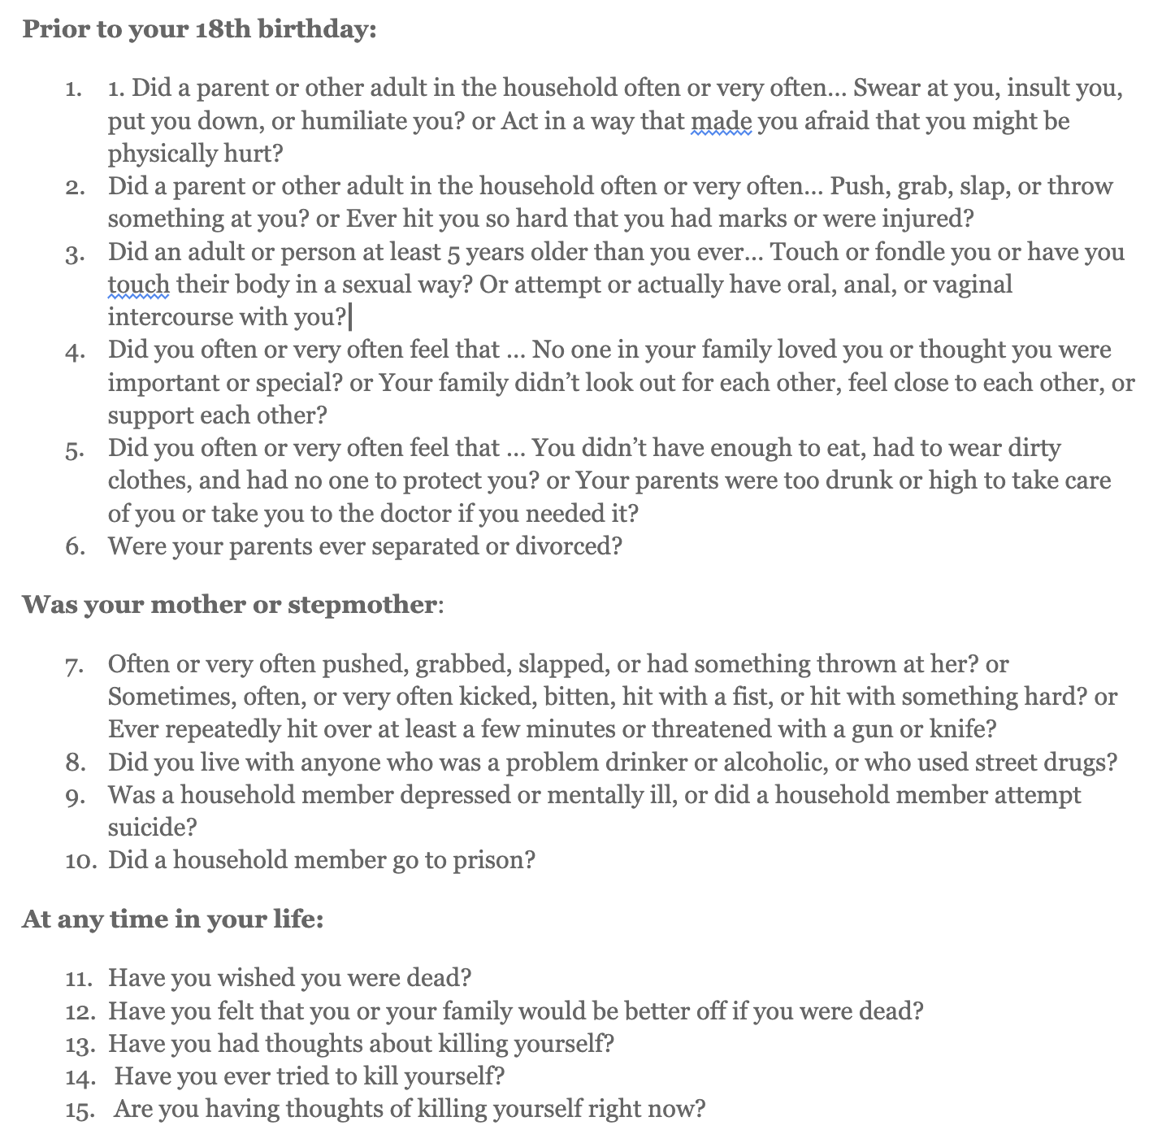
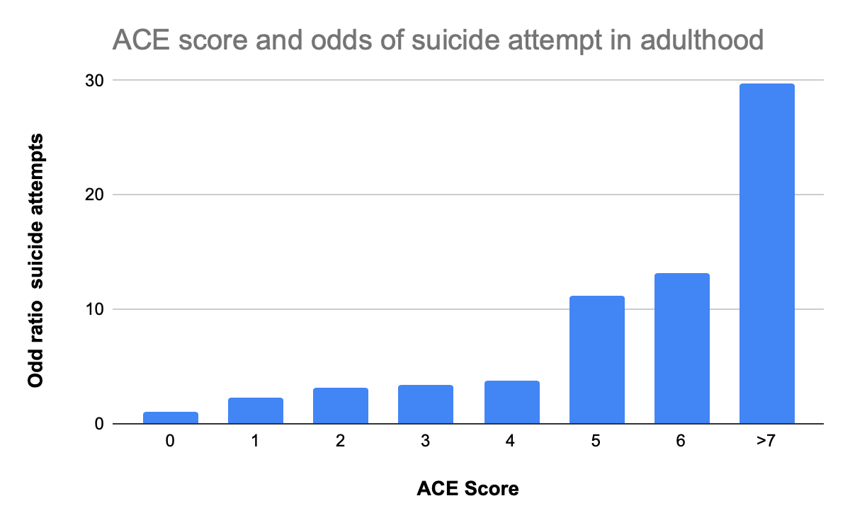
Adverse Childhood Experiences as a Risk Factor for Suicidal Ideation and Behavior in Public Safety Professionals
Background
Results
Elizabeth Esty, MD; University of Colorado Residency in Occupational and Environmental Medicine; Colorado School of Public Health, MPH and Total Worker Health candidate
Public safety professionals (PSP), including firefighters, law enforcement officers, emergency medical service professionals and 911 dispatchers, demonstrate higher prevalence of suicidal ideation, suicide attempt and completed suicide compared to the general population in the US. Recurrent exposure to traumatic events at work, disrupted sleep due to shift work, higher rates of substance use disorders, work culture factors and easy access to lethal means all contribute to suicide risk. While PSP in the US are disproportionately drawn from demographic groups at elevated risk of suicide (such as white, male, and/or military veterans), elevated rates of suicidality appear to persist when adjusted for these demographic factors.
The number of adverse childhood experiences (ACE) self reported by adult individuals has been shown to correlate strongly with suicide risk, with ACE scores greater than 4 associated with dramatically increased risk of suicidality. Anecdotal evidence suggests a higher prevalence of childhood trauma among PSP compared to other occupational groups, though there is insufficient data available to conclusively confirm or challenge this contention. In either case, some of the suicide risk PSPs face is likely attributable to childhood adversity.
A survey comprised of the ACE Questionnaire and the preliminary screening tool of the ASQ suicide risk assessment:
Methods
A literature review found a consistent (though heterogeneous) body of quantitative and qualitative research supporting increased suicidality in PSP. A second literature review identified a consistent, strong, linear association between number of ACEs and suicidality in adults. Existing measures of ACEs were reviewed, and the original ACE questionnaire (Felitti,1998) was selected as one component of the survey. A review of existing, validated suicide risk assessment tools was conducted, and the Ask Suicide-Screening Questions (ASQ) was selected as the second component of the survey on the basis of its brevity and clarity. The ASQ toolkit includes algorithms to guide management and disposition of acutely suicidal respondents—a decisive advantage, particularly if the survey is administered without anonymity. The feasibility, acceptability, and utility of the survey were discussed with health and wellness leaders within both the Denver Police Department and Denver Fire Department. Representatives of these public safety organizations agreed that many of their workers likely had experienced greater than average numbers of ACEs. They indicated that efforts to improve suicide prevention efforts were of high importance. but that eliciting responses to survey questions on sensitive topics may be challenging.
Objectives
The aim of this project is to develop a survey to assess the lifetime prevalence of suicidality and the number of ACEs experienced by employees of PSP organizations. In addition to validity and reliability, the feasibility, acceptability and safety of the survey are of clear importance. Development of the survey will be conducted in consultation with leaders in PSP organizations. Such consultation will also inform the choice of mode(s) of survey administration and the development of explanatory materials to accompany the survey.
With adequate sample size, survey results may improve estimates of the true prevalence of suicidality and elevated ACE scores in PSP occupational groups and may help characterize the relationship between ACE score and suicidality in PSP workers. Results may also be used to assess individual risk and/or characterize the overall ACE-related health risk of an organization’s employees. Finally, identifying PSP who are at increased risk of suicide by virtue of adverse childhood experiences may inform suicide prevention efforts in PSP organizations.
Implementation
Pilot use of this survey at the Denver Fire and/or Denver Police Departments will test acceptability. Stigma and privacy concerns are potential barriers to obtaining candid responses. Particularly if administered anonymously, safety concerns surrounding asking about suicidality (and to a lesser extent) childhood adversity must be addressed. Administration of the ACE questionnaire alone could establish higher prevalence of ACE in PSP.

