Slide 1
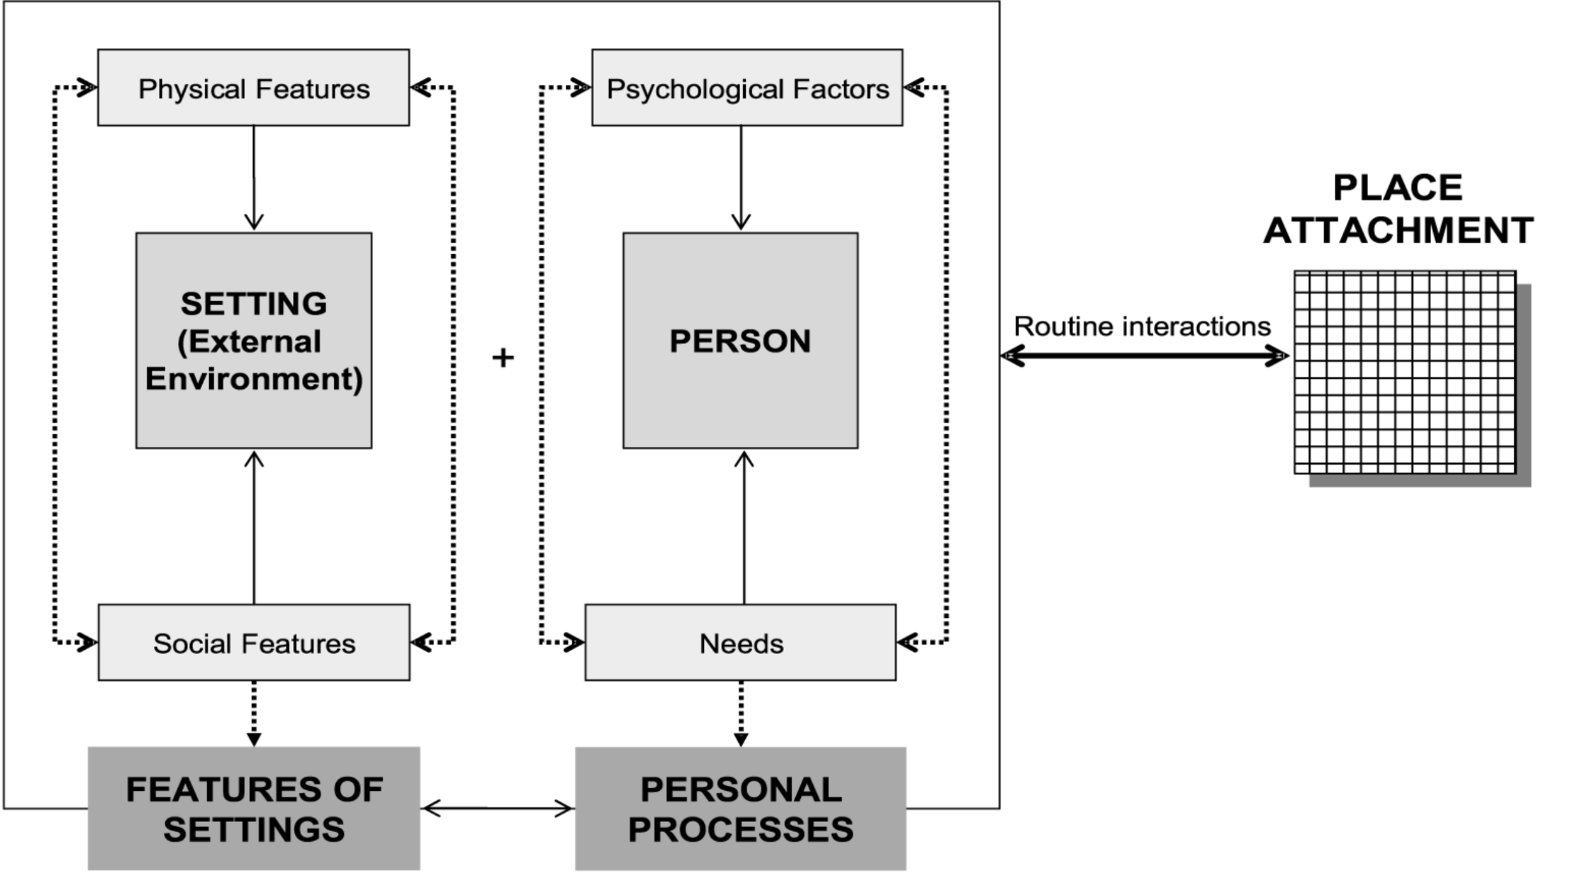
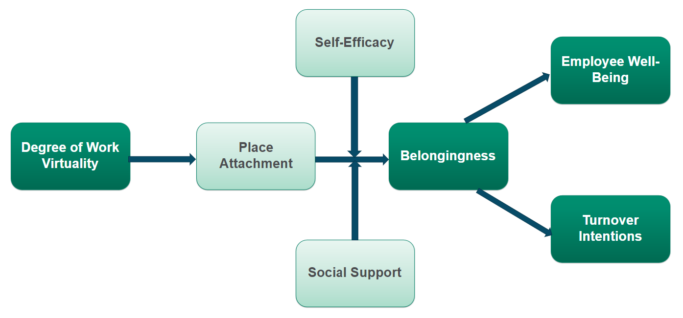
Work from Office or Home – Why Does it Matter?
Kinjal Chheda, M.S., Mary Lynne Larson, & Danielle Gardner, Ph.D.
Methods & Analysis
Introduction
Frameworks
Participants
  N = 500
  18+ years old
  Part/Full-time employees
  Working either remotely/in-person/hybrid
Method
  Longitudinal – 3 time points; 2 weeks apart
  Online questionnaire via Amazon Mturk
Analyses
  Moderation-mediation analyses – SEM
Belongingness is the fundamental need that humans drive to satisfy (Allen et al., 2021). Critical for inclusion!
  4 interrelated components (Allen et al., 2021) - competencies for belonging, opportunities to belong, motivations to belong, and perceptions to belong.
Loyalty is determined by social and place attachment (Inalhan & Finch, 2004).
39% exclusively remote; 42% hybrid; 19% fully on-site (Gallup, 2022)
In-person --> hybrid/virtual settings undermines our ability to form attachments with people, places, and companies (Inalhan & Finch, 2004) --> reduce sense of belonging and mental health in general (Fullilove, 1996)
Social learning theory (Bandura, 1977) explains the moderating roles of self-efficacy & social support
Implications
Main Question: Should the natural human condition for place attachment be protected in an increasingly changing workstyle to feel a sense of belonging?
Fig 1. Sourced from Inalhan & Finch (2004) that adapted from Steele (1981)
Explores the current gaps in our understanding of "attachment" to workplaces as a phenomenon in relation to belongingness
Emphasize the importance of belongingness in enhancing employee well-being and reducing turnover intentions
A step to improved theoretical foundation, research measurements, and practitioner tools & interventions
Transformation solutions should be undertaken with thorough consideration.
  25% of major change initiatives fail
Organizations can employ ways to empower workers, enhance their self-competence, and relatedness
Objectives
Investigate the difference in the sense of belongingness across the degree of virtuality (remote, hybrid, in-person) and its effects on well-being and turnover intentions.
Examining the roles of place attachment as a mediator, and self-efficacy and social support as two moderators.
Fig 2. My hypothesized model
Contact at kinjal.chheda@colostate.edu for references and/or questions/concerns

Slide 2
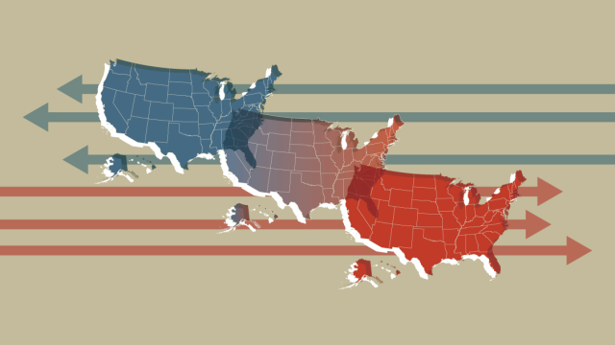
Red, White, and Who?: An investigation on how political identities impact safety behaviors in the workplace
Hannah M. Finch
Background
Objectives
Over the last 30 years, the United States become more politically involved and polarized, reaching record numbers of voting behaviors (Pew Research Center, 2014; Pew Research Center, 2020). Unfortunately, research has also found that individuals are becoming less understanding of each other and over 25% of each party’s members believe that the opponents’ beliefs and policies are detrimental to the well-being of the country (Pew Research Center, 2014).
With politics becoming more of a hot topic in today’s society, the goal of this research study is to investigate the impacts that diverse political ideology has on the workplace. Specifically, I hope to evaluate goal orientation, psychological well-being (e.g. burnout and emotional labor), and safety voice behaviors for individuals whose beliefs differ from the perceived organizational political ideology.
(Image: Pew Research Center, 2020)
Saliency of Political Attitudes
Hypotheses
Methods
H1: The dissimilarity of one’s political identity from coworkers/organization will lead to increased emotional labor (surface and deep acting) and burnout.
H2: The dissimilarity of one’s political identity from coworkers/organization will lead to decreased safety voice behaviors and goal orientation.
H3: These relationships will be mediated by the saliency of the individual’s political identity attitudes.
Safety Voice Behaviors
Recruit ~500 U.S. participants nationwide via Amazon’s MTurk
One screening survey: demographics, industry, political saliency, organization political identity, political dissimilarity
Experience sampling methodology: Two-week survey, every day in the afternoon
Participant compensation, including bonuses for completing 95% of surveys
Political ID
Dissimilarity
Goal Orientation
Emotional Labor
Burnout

Slide 3


Item Generation and Validation to Assess the Science-Practice Gap in Occupational Health Psychology
A Survey of Subject Matter Experts
James Kunz, Gwenith G. Fisher, Richard Boustred
Colorado State University
INTRODUCTION
Unlike other areas of I/O psychology, to our knowledge no research has investigated where science-practice gaps exist within OHP^{1,2}
This research is essential to ensure OHP research is improving workers’ lives
It is also essential to ensure items used to investigate the science/practice gap in OHP are validated³
In this context, item validation refers to the extent survey items reflect what they are intended to measure⁴
METHOD
We will survey 5-7 subject matter experts (SME)
Items will have response options of true/false/uncertain
SMEs will respond to items and then answer questions about each item’s clarity, relevance, and importance to health professionals
We will invite SMEs to respond to open-ended questions and to suggest items of their own
Means, standard deviations and intra-class correlation coefficients (ICCs) for quantitative responses will be calculated
OHP item ratings will be compared to ratings training SMEs give to training items that have already been validated
POTENTIAL IMPLICATIONS
This research will help eliminate, generate, and refine items for a more robust measure of the science/practice gap in OHP
Results may also serve as a benchmark for future research assessing the OHP gap
Investigating what survey items will best assess the occupational health psychology (OHP) science-practice gap among health professionals
Example Items | Research Evidence
Within organizations, mindfulness meditation interventions reduce stress most (False) | (Richardson & Rothstein, 2008)
The best way to recover from work is by mastering a hobby (False) | (Sonnentag & Fritz, 2014)
Approximately half of organizations offer workplace health promotion programs to employees (True) | (Integrated Benefits Institute, 2022)
Females are more likely to experience accidents in the workplace than males (False) | (Jo et al., 2017)
Compared to sleep-impaired workers, well-rested workers are less likely to engage in unethical behavior (True) | (Welsh et al., 2018)
Workplace accidents are more likely to happen when employees feel pressure to meet deadlines (True) | (Kaplan & Tetrick, 2011)
When employees have a free workplace health promotion program available to them, typically more than half utilize it (False) | (Lier et al., 2019)
Research Questions:
Are items consistent with
published findings?
How can items be improved?
Are items clear and easy to understand?
References
¹Rynes, S. L., Colbert, A. E., & Brown, K. G. (2002). HR professionals' beliefs about effective human resource practices: Correspondence between research and practice. Human Resource Management, 41, 149-174.
²Fisher, P. A., Risavy, S. D., Robie, C., König, C. J., Christiansen, N. D., Tett, R. P., & Simonet, D. V. (2021). Selection myths: A conceptual replication of HR professionals’ beliefs about effective human resource practices in the US and Canada. Journal of Personnel Psychology, 20, 51-79.
³DeVellis, R. (2012). Scale development: Theory and applications. Sage.
⁴Raykov, T., & Marcoulides, G. A. (2011). Introduction to psychometric theory. Routledge.
Are there items that can be added?
Do items measure something of practical importance?
Notes:
SMEs must have earned a Ph.D. in the relevant field (IO psychology, management), published/and or practice on the topic/area relevant to the items they are evaluating items from or have served on an editorial board or reviewer for the subtopic (e.g., training, OHP, feedback/appraisal). SMEs will be invited to participate as SMEs in the proposed study via professional organization (e.g., Society of Occupational Health Psychology) listservs.

Slide 4


A Qualitative Exploration of Code-Switching in Black Employees
Shelby N. Davis, Courtney Bryant, Karina Olave, Danielle Gardner
Introduction
Key Findings
Implications
Code-switching (CS) occurs when people temporarily “switch on” or adjust behaviors to manage the impressions they make on others, typically for a desired outcome
Parallel-Constraint-Satisfaction Theory (PCST) posits that people consider common stereotypes and individual behavior as interpretations are shaped to match stereotypical expectations
Negative stereotypes of Black individuals can lead to biases at work; aware of these stereotypes, Black employees attempt to manage or shift their identities at work to match the norms and standards of professionalism
Research has found that CS reduces the amount of authenticity that Black employees exhibit at work, which can lead to decreased well-being
“This is nothing more than when a chameleon changes colors to blend into the dark to avoid predators”
~ Quote from participant
The current study aimed to identify (a) the potential antecedents of CS, (b) the behaviors involved in CS, and (c) the potential impacts/ consequences of CS
We took an interactive thematic coding approach, allowing themes to arise naturally
This information could potentially:
Help future researchers assess the direct relationship between code-switching and occupational health hazards
Lead to the development and/or enhancement of organizational policies and procedures that aim to reduce biases that are influencing the need or desire to code-switch by Black employees
Future Directions:
Using previous code-switching literature and the themes found in this study we hope to develop and validate a code-switching scale centered around Black employees' experiences
Antecedents
Organizational Influences
Societal Influences
Personal Influences
Outcomes
Negative Job Outcomes
Positive Job Outcomes
Emotional Fatigue
Behaviors
Language
Physical Appearance
Work-Life Separation
Change in Disposition
Methods
“It's tiring. It's definitely tiring at times. I feel like it's so necessary… I probably don't even know how to how to stop… I wish that I could just be myself at every job and all the time, but I mean, you know, it can't happen.” ~ Quote from participant
We conducted a qualitative analysis of semi-structured interviews of Black employees
Participants:
N = 17
83.3% Female
M = 37.22 years of age
All participants self-identified as Black, African American, or African
Questions:
“How do you change (or not change) yourself at work?”
“Why do you change (or not change) aspects of yourself with others at work,”
“How does changing yourself at work affect you?”
“How do others react to you when you change yourself at work compared to when you do not?”

Slide 5

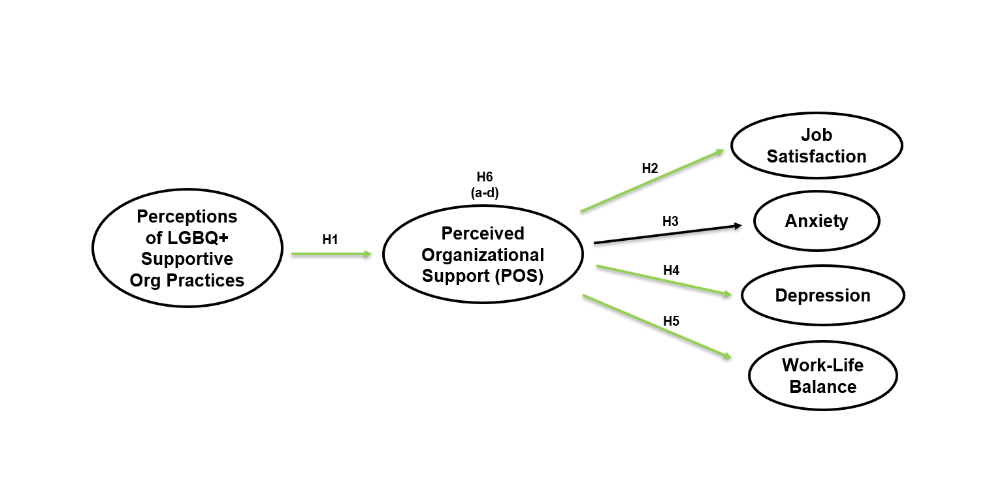
Perceptions of Supportive Organizational Practices and Well-being among LGBQ+ Employees
Rachel Perpich & Gwen Fisher, Ph.D., Colorado State University
Abstract
What is the relationship between perceptions of LGBQ+ supportive organizational practices, perceptions of support, and indicators of
well-being for LGBQ+ employees?
REFERENCES AVAILABLE UPON REQUEST
Please email: rachel.perpich@colostate.edu
The purpose of the current study is to examine relationships between perceptions of supportive organizational practices, perceived organizational support, and well-being indicators among LGBQ+ (lesbian, gay, bisexual, queer, etc.) employees, an important and often understudied group of workers. Participants identifying as LGBQ+ (n = 353) were recruited via Prolific to complete two surveys at two time points. The results indicate that perceptions of LGBQ+ supportive practices are related to job satisfaction and work-life balance through the mechanism of perceived organizational support. These findings provide organizations with empirical data to better support and facilitate well-being for LGBQ+ employees.
Analyses
Data were screened for insufficient-effort response (IER) via failed attention check items and fast response times
Hypotheses were tested by conducting a structural equation model in R
Figure 1. Hypothesized Model
Results
Background
Perceptions of supportive practices was positively related to perceptions of organizational support
Perceived organizational support was related to job satisfaction, depression symptoms, and work-life balance in the hypothesized directions
Perceived organizational support served as a mediator between perceptions of LGBQ+ supportive practices and two of the well-being indicators: job satisfaction and work-life balance
More research is needed to assess the relationship between mental health symptoms and perceptions of LGBQ+ supportive organizational practices
“LGBQ+” refers to lesbian, gay, bisexual, queer, or other sexual orientations other than heterosexual (Dillon et al., 2011)
Total Worker Health® model suggests worker well-being is integrative, and is comprised of an individual’s health and work-related environmental, organizational, and psychosocial factors (Chari et al., 2018)
Organizations may enact policies and practices to support LGBQ+ employee well-being (Opall, 2021), including:
  Prohibiting sexual orientation discrimination/harassment
  Providing effective diversity training
  Extending benefits to same-sex domestic partners
Organizational Support Theory (Eisenberger et al., 1986) and Social Information Processing Theory (Salancik & Pfeffer, 1978) propose that employees use social information from their environment to build perceptions of organizational support
Note: Green arrows indicate significant hypotheses
Table 1. Hypotheses of direct and indirect effects
Limitations
 | Hypotheses – Direct Effects | β
H1 | Perceptions of LGBQ+ supportive organizational practices will be positively related to perceptions of organizational support. | .735***
H2 | Perceived organizational support will be positively related to job satisfaction. | .535***
H3 | Perceived organizational support will be negatively related to anxiety symptoms. | Not significant
H4 | Perceived organizational support will be negatively related to depression symptoms. | -.245**
H5 | Perceived organizational support will be positively related to work-life balance. | .333***
 | Hypotheses – Indirect Effects
H6a | Perceived organizational support will mediate the relationship between perceptions of LGBQ+ supportive organizational practices and job satisfaction. | .245***
H6b | Perceived organizational support will mediate the relationship between perceptions of LGBQ+ supportive organizational practices and anxiety symptoms. | Not significant
H6c | Perceived organizational support will mediate the relationship between perceptions of LGBQ+ supportive organizational practices and depression symptoms. | Not significant
H6d | Perceived organizational support will mediate the relationship between perceptions of LGBQ+ supportive organizational practices and | .393***
Notes: N = 353. * p <.05 ** p <.01 *** p <.00. Standardized estimates (path coefficients presented for direct and indirect effects.
Self-report data may reflect common method variance (CMV)
Unable to determine which supportive organizational practices demonstrate the strongest relationships with aspects of well-being for LGBQ+ workers
Method
Sample
LGBQ+ employees working at least 20 hours/week (n = 353)
  Bisexual (45.9%), Gay (16.4% ), Lesbian (11.3%), Pansexual (9.9%), Queer (7.6% ), Asexual (7.4%) , Other (0.3%)
Data Collection
Participants were recruited via Prolific to complete two anonymous online surveys two weeks apart
  Time 1 Measures: personal and professional demographics, perceptions of organizational support and practices.
  Time 2 Measures: indicators of well-being including job satisfaction, poor mental health symptoms, and work-life balance
Contributions
Extends current literature on experiences and perceptions of LGBQ+ employees
Provides empirical support for the mediating role of perceived organizational support for job satisfaction and work-life balance
Investigated the intersection between minority status and worker well-being using the TWH® framework to answer the call of incorporating diverse perspectives in occupational health research
Acknowledgement:
This research was supported by the National Institute for Occupational Safety and Health (NIOSH) Mountain and Plains Education and Research Center (T42OH009229)
:
Notes:
5

Slide 6




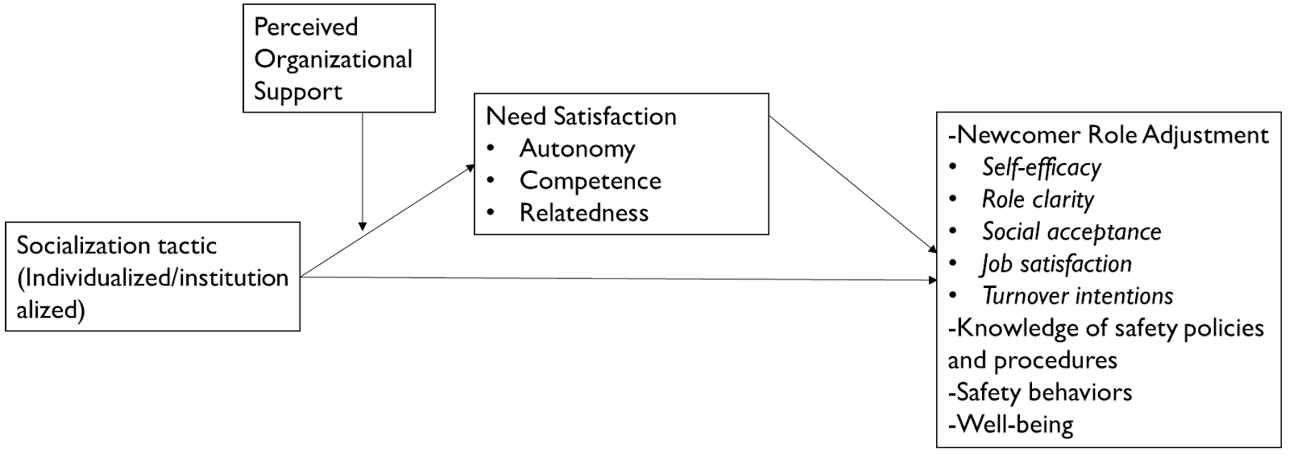
Addressing Newcomer Adjustment, Well-Being, and Safety through Organizational Support and Self-Determination Theory
Rosalyn Stoa, M.S., Colorado State University
1. What is the problem?
2. How do we increase newcomer safety?
3. How can OHP help?
New employees go through a socialization process, from:
Other factors such as:
Perceived organizational support (Eisenberger, 1986)
Autonomy, competence, and relatedness (Deci & Ryan, 1985)
May influence newcomer role adjustment, including knowledge of safety policies and procedures, safety behaviors, and newcomer well-being.
Individualized (a more informal, autonomous process) (Jones, 1986)
Institutionalized (a more formal, organized process)
New employees are at increased risk of occupational injury and illness
(Bena et al., 2013)
Socialization is related to increased newcomer safety (Campbell Quick et al., 2014) but we don’t know how…
4. Proposed Research
5. Implications
Research Implications:
Further investigating autonomy, competence, and relatedness as a potential model to understand socialization
Understand how socialization tactics influence safety behaviors
Practical Implications
Development of socialization practices to address newcomer safety behaviors and wellbeing
H3
H2
Longitudinal study over 6 months
Participants (N = 700) are:
In a job/industry with increased risk of occupational injury or illness
Have started the job within 3 months of the first data collection
Work with other individuals
H1
This research was supported by the National Institute for Occupational Safety and Health (NIOSH) Mountain and Plains Education and Research Center (T42OH009229)

Slide 7



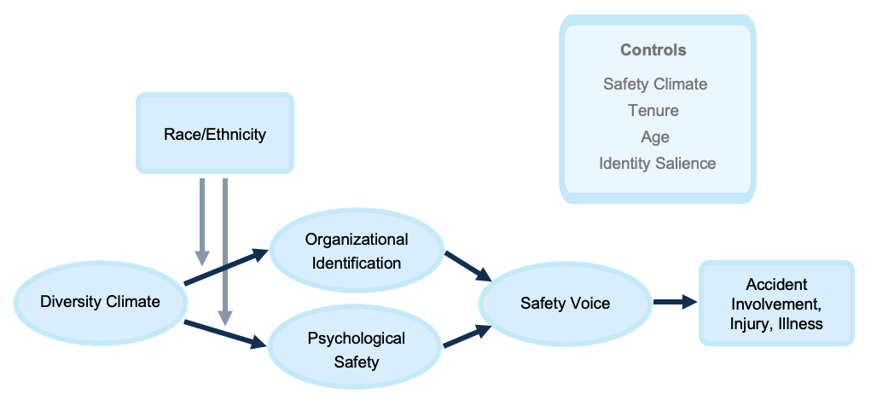



Promoting Safety through Diversity Management:
Diversity Climate, Racial Ethnicity, & Safety Voice
Julia L. O. Beckel
Project Overview
Specific Aims & Objectives
Study Design
Non-Hispanic Black and Hispanic workers hold an undue burden of work-related disability in the United States, contributing to occupational health disparities
N = 450 participant sample
Employed in high-risk industry
Identify as Non-Hispanic Black, White, or native/foreign-born Hispanic
18+ years of age
RQ1: How do individual perceptions of diversity climate relate to worker safety voice?
This study proposes differences in safety voice underly racial-ethnic differences in occupational health outcomes
RQ2: Do psychological safety and organizational identification explain the relationship between diversity climate and safety voice?
RQ3: Do racial differences moderate the relationship between diversity climate and safety voice, via differences in organizational identification and psychological safety?
Online questionnaires via Prolific
Three time-points
Fully cross-lagged
Scales corresponding to variables of interest
Safety voice, or speaking up on safety, is an empirical contributor to occupational injury and illness prevention
RQ4: Are any racial/ethnic differences in worker safety voice associated with differences in involvement in near misses, accidents, and/or injury?
Propose psychological diversity climate as an antecedent to safety voice, lending to these racial-ethnic differences
Multi-group Structural Equation Modeling
Hypothesized Model
Conceptual Framing
Implications
  Pro-diversity climates associated with greater organizational identification and psychological safety among minority racial/ethnic groups
Demonstrate association between diversity management and occupational safety
Further explain the occurrence of occupational health disparities
  Diversity climate more strongly and indirectly effects extra-role behaviors via psychological safety for minority racial/ethnic participants.
Identify an actionable mechanism (i.e., diversity climate) for encouraging safety communication and the reduction of workplace hazards
  Organizational identification and psychological safety associated with greater extra-role behaviors and employee voice behaviors, generally.
Merritt, S. M., Ryan, A. M., Mack, M. J., Leeds, J. P., & Schmitt, N. (2010). Perceived ingroup and outgroup preference: A longitudinal causal investigation. Personnel Psychology, 63(4), 845-879.
Singh, B., Winkel, D. E., & Selvariajan, T. T. (2013). Managing diversity at work: Does psychological safety hold the key to racial differences in employee performance? Journal of Occupational and Organizational Psychology, 86(2), 242-263.
Seabury, S. A., Terp, S., & Boden, L. I. (2017). Racial and ethnic differences in the frequency of workplace injuries and prevalence of work-related disability. Health Affairs, 36(2), 266-273
Notes:
Merritt, S. M., Ryan, A. M., Mack, M. J., Leeds, J. P., & Schmitt, N. (2010). Perceived ingroup
and outgroup preference: A longitudinal causal investigation. Personnel
Psychology, 63(4), 845-879.
Singh, B., Winkel, D. E., & Selvariajan, T. T. (2013). Managing diversity at work: Does
psychological safety hold the key to racial differences in employee performance? Journal
of Occupational and Organizational Psychology, 86(2), 242-263.
Seabury, S. A., Terp, S., & Boden, L. I. (2017). Racial and ethnic differences in the frequency of
workplace injuries and prevalence of work-related disability. Health Affairs, 36(2), 266-273.

