Slide 1
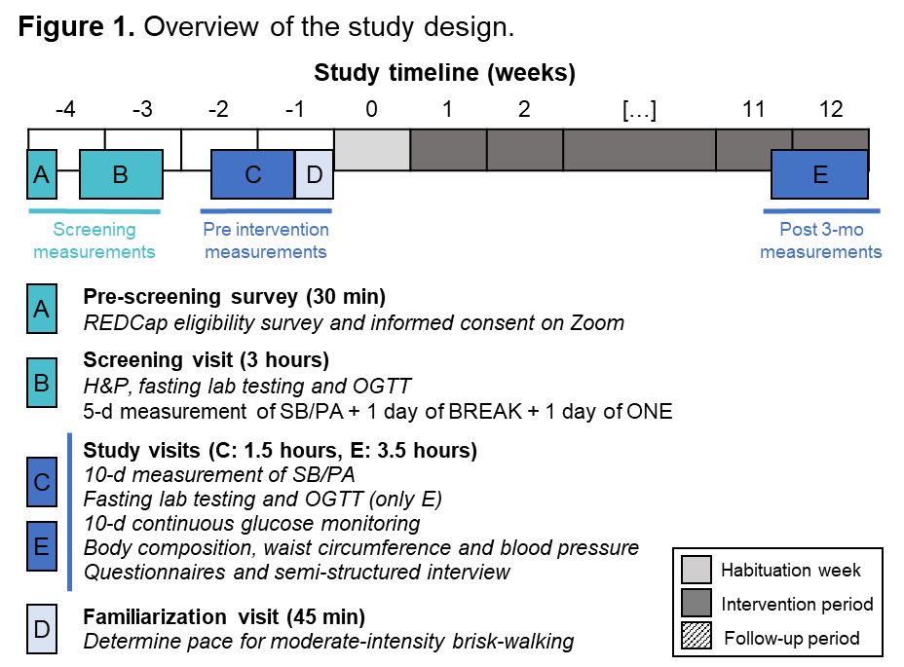
Active breaks in prolonged sitting versus continuous physical activity on behavioral and health-related outcomes in office workers with prediabetes: A pilot study
Ana J Pinto¹, Carmen Ortega-Santos¹, Melissa L Mamele¹, Patricia R Smith¹, Sheila Steinke¹, Zhaoxing Pan¹, Kevin Masters¹, Daniel H Bessesen¹, Audrey Bergouignan^{1,2}
¹ University of Colorado Anschutz Medical Campus, Aurora, CO; ² CNRS IPHC UMR7178, Strasbourg, France
Background
Methods
Preliminary Results
Sedentary behavior (SB) is associated with chronic diseases and all-cause mortality.
The workplace has been identified as a key setting for accumulating SB with office workers being one of the most vulnerable occupational groups.
Though physical activity (PA) is typically advocated, people may find it impractical to perform 30-60-min PA bouts during a workday.
Active breaks in sitting emerge as an alternative that may be more feasible to reduce SB during work hours.
This is a 3-month, parallel-group, randomized controlled trial. Twenty-eight (50%F) sedentary, adult office workers with prediabetes and overweight/obesity are being randomized to ONE (45-min/d bout of brisk walking, 5 d/wk) or BREAK (9 hourly 5-min bouts of brisk walking, 45 min/d total, 5 d/wk) (Figure 1).
Outcomes are being assessed before and after 3 months of intervention:
Objectively measured daily patterns of SB/PA (accelerometers; primary outcome).
Fasting glucose, insulin and lipids, HbA1c.
Glucose control (OGTT and CGM).
Body composition (DXA), waist circumference.
Blood pressure.
Mood, vigor, fatigue, well-being (questionnaire).
Barriers/facilitators to SB/PA (semi-structured interviews and weekly meetings).
To date, 11 participants have been randomi-zed. Among them, 7 are performing the PA interventions and 4 have completed the study. Participants’ characteristics are presented in Table 1. Eight participants (73%) have hybrid working schedule. Adherence to PA is 90±16% and 95±7% in ONE and BREAK. Preliminary data on work-related barriers and facilitators for ONE and BREAK are presented in Table 2.
Table 1. Participants’ characteristics.
Table 2. Work-related barriers and facilitators to PA interventions.
Objectives
To explore the behavioral and health-related effects of active breaks in sitting vs a continuous bout of PA, as well as barriers and facilitators to implement interventions in the workplace and free-living.
Impact and significance
Successful completion of this pilot study will provide novel data on the distinct effects of breaking up SB with brief PA bouts on behavioral and health-related outcomes in office workers. Findings on barriers and facilitators will help to improve implementation of PA interventions for future large-scale trials. Finally, this pilot study can also inform future policies and practices related to PA in the workplace and diabetes prevention.
Figure 1. Overview of the study design

Slide 2
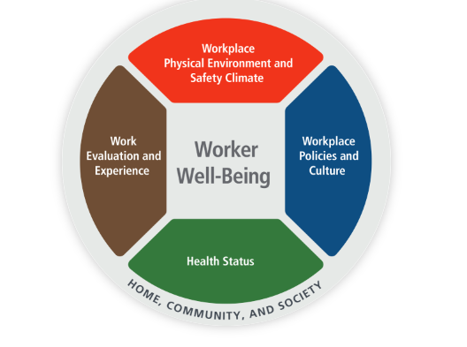
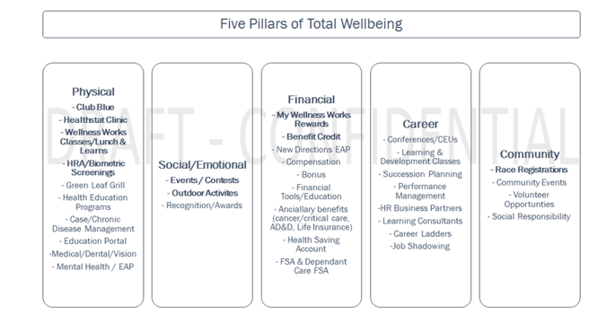
5 Pillars of Wellness
Stephanie Jones MPH, RD, LD, CHES® at Arkansas Blue Cross Blue Shield
Total Worker Health Graduate Certificate Program, funded by CDC/NIOSH T42 OHOO9229 Mountain & Plains Education and Research Center
Background
Methods
Results
The mission of ABCBS is to ensure the health, wellbeing and financial security of our members. Shifting our wellness program to incorporate the five pillars is our homegrown approach to touching more than 3,000 members directly or indirectly.
Change in requirements for Health Benefit Credit
Incorporate all 5 pillars in wellness programming
Community support with vaccine drives, race sponsorship and Mental Health First Aid Training
Net Promotor Score
2021 9.45
2022 9.57
Employee Engagement
2021 83%
2022 81%
Health Benefit Credit
2019 2685
2022 2791
Objectives
Recommendations
-More research is needed to provide adequate comparison with changes implemented
-Employee wellness programs may consider using participation-based programming vs. outcomes-based reporting
-Supporting whole person health is more than just physical health
Shift in Wellness Programming for ABCBS employees to incorporate the five pillars of wellness.
Physical
Social/Emotional
3 Financial
4 Career
5 Community

Slide 3
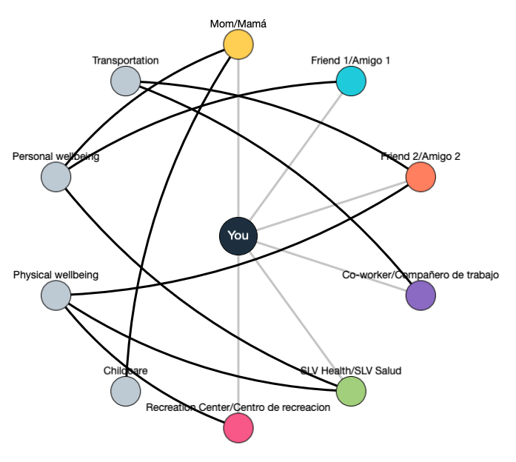
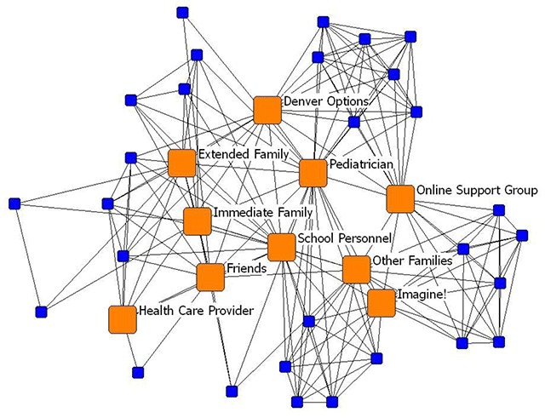
A Network Analysis to Establish a Total Worker Health® Behavioral Health Intervention for the Agriculture Workforce of the San Luis Valley, Colorado
Nick Stoll and Katherine A. James, PhD, MS, MSCE
Background
Results
Agriculture workers and rural America is experiencing a behavioral health crisis
Stressors include weather/climate events, chronic illness, high demand occupations, barriers to healthcare, and economic volatility
A third of the San Luis Valley (SLV) population is employed in the agriculture industry
The SLV Population is largely Hispanic/Latino, and has some of the lowest median household income in Colorado
Community members are calling for behavioral health assessment
233 survey responses
~50% completed online
96% Hispanic/Latinx
56% female
Methods
Next Steps
Our research plan outlined a stratified-random sample of 250 agriculture workers. We developed an interactive online survey and in-person physical survey for data collection:
Social network mapping
Individual needs assessment
NIOSH WellBQ
CES-D
GAD-7
Organizational survey to assess operating capacities and service populations
Social Network Analysis
Identified Priority Needs
1.
2.
3.
4.
5.
Access to nutritious food
Assistance with housing and utilities
Reliable transportation
General finances
Mental health
Other prominent needs are also identified.
Notes:
Talking points
Background:
Methods:
By attending local community events, members of our research team have successfully recruited individuals who later participated online at home
Hosting our own recruitment events that provided food to the community and connections to local behavioral health resources drastically increased participation through physical surveys
The TWH® modeled by the WellBQ also incorporates aspects of health status and home, community, and societal wellbeing that are also relevant to the individual within the context of their occupation
Results:
Conclusion/Next Steps:
Community led research is only successful when the research is tailored to the communities' unique characteristics
While the community has had a more immediate response to in-person and survey packet materials, data collected online is more rich in information gathered
We believe that CU-hosted recruitment events have seen lower completion rates due to fixed interest in gift card incentives

Slide 4
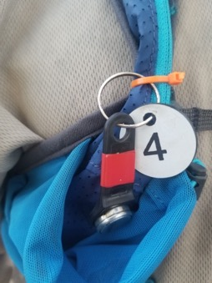
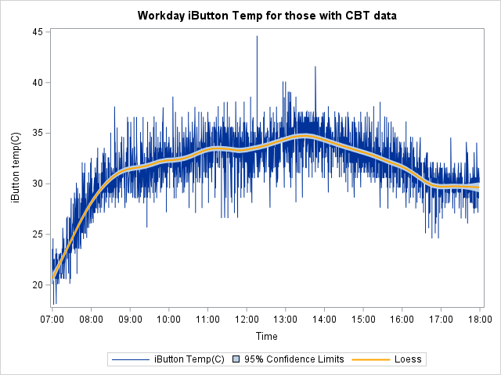
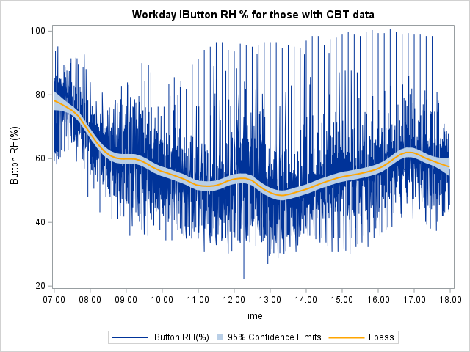
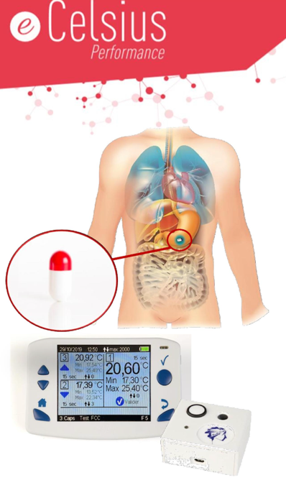
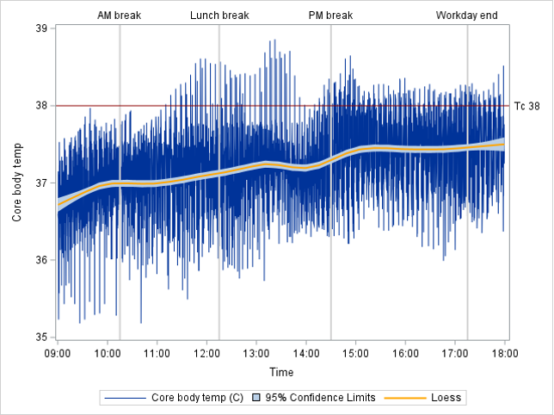
Occupational Heat Exposure and Effect Among Guatemalan Sugarcane Workers
Lyndsay Krisher^{1,2}, Diana Jaramillo¹, Jaime Butler-Dawson^{1,2}, Miranda Dally^{1,2} , Karely Villarreal Hernandez¹, Nicholas Smith³, Lee Newman^{1,2}
Background
Methods
Results
Agricultural workers, including sugarcane workers in Guatemala, are at high risk for heat related illness and other health effects due to heavy labor in the heat, which are likely to be exacerbated by globally warming temperatures resulting from climate change.
Working strenuously above 35°C is associated with increased risk of heat stress.
Occupational heat stress is believed to be common in this worker population but has rarely been measured objectively, such as through core body temperature (Tc). A Tc >38°C indicates heat stress.
Data were collected from 41 workers over six days
during the sugarcane harvest in Guatemala:
  Heat exposure during work shift: ambient temperature
  and humidity using HygrochronTM iButtons (Fig 1)
  Core body temperature (Tc) using pill-sized ingestible capsules (Bodycap e-Celsius Performance®) (Fig 2)
Fig 1: iButton on worker’s uniform
High proportion of workers with heat stress (41% overall, Table 1), especially on hotter, more humid days (Study Days 3 & 4).
Workers’ Tc increased on average across the workday and did not appear to recover following scheduled rest breaks (Fig 5).
Over course of workday, Tc continued to rise even after ambient temperature began to fall in the late afternoon and humidity began increasing (Fig 3 & 4).
Fig 3 & 4: Ambient temperature (°C) and relative humidity (%) across workday. Overlaying the observations is the LOESS estimated curve of central trend (solid line) with 95% confidence limits. Blue lines show range of observations.
Table 1: Summary of workday exposure data and frequency of heat stress and symptoms by Study Day
Study Day | N | iButton Temp mean (SD) max (C) | iButton RH mean (SD) max (%) | Tc mean (SD) max (C) | Exceeded 38 T_{c}* N (%)
1 | 6 | 31.6 (2.8) 37.6 | 59.9 (11.5) 93.2 | 37.20 (0.47) 38.62 | 3 (50%)
2 | 6 | 30.7 (3.1) 37.1) | 61.9 (9.6) 91.4 | 36.98 (0.54) 38.27 | 1 (17%)
3 | 6 | 31.6 (3.1) 41.6 | 62.3 (14.9) 100.8 | 37.40 (0.54) 38.35 | 4 (67%)
4 | 9 | 31.8 (3.8) 44.6 | 50.7 (14.2) 95.2 | 37.40 (0.56) 38.86 | 5 (56%)
5 | 6 | 31.6 (3.5) 37.1 | 54.2 (13.6) 86.1 | 37.13 (0.40) 38.14 | 1 (17%)
6 | 8 | 32.1 (3.6) 40.1 | 57.8 (11.3) 92.6 | 37.14 (0.53) 38.52 | 3 (38%)
Overall | 41 | 31.6 (3.4) 44.6 | 57.3 (13.5) 100.8 | 37.21 (0.53) 38.86 | 17 (41%)
Objectives
Fig 3
Fig 4
Fig 2: Tc measurement
system
The primary objective is to characterize occupational heat exposure and effect (Tc), among a group of Guatemalan sugarcane workers.
We conducted exploratory analyses to determine the efficacy of recovery periods (i.e., shift breaks).
Fig 5. Time series of Tc across the workday with rest breaks and Tc=38 indicated. Overlaying the observations is the LOESS estimated curve of central trend (solid line) with 95% confidence limits. Blue lines show the range of observations.
Recommendations
Examine course of heat exposure & effect during off-work hours / post-shift recovery period when workers are home in their community. Assess correlation between iButton data and Tc.
Evaluate associations with health outcomes.
Conduct longitudinal studies to understand cumulative effects of daily heat stress + exertion over long term.
Fig 5
Acknowledgements: We wish to thank all our collaborators including Alex Cruz, Daniel Pilloni, Inés Amenabar and all the workers who have made this work possible.
Special thanks to my dissertation committee: Elizabeth Carlton, Kathy James, Mary Hayden, Evan Johnson and Lee Newman.
Affiliations: ¹Center for Health, Work, & Environment, Colorado School of Public Health, University of Colorado (CU),
²Department of Environmental and Occupational Health, Colorado School of Public Health, CU, ³Universidad Francisco Marroquín, Guatemala City
Funded in part by Center of Excellence for Total Worker Health® Cooperative Agreement U19OH011227, funded by the Centers for Disease Control and Prevention and the National Institute for Occupational Safety and Health (NIOSH). The authors declare no conflicts of interest.

Slide 5
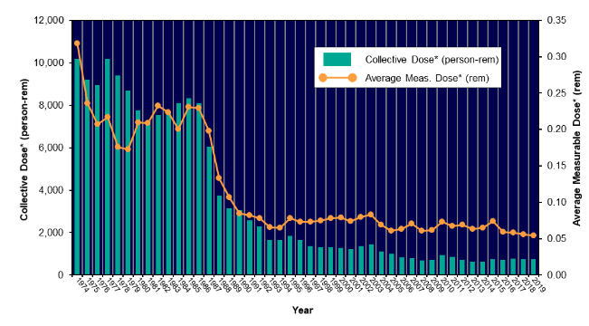
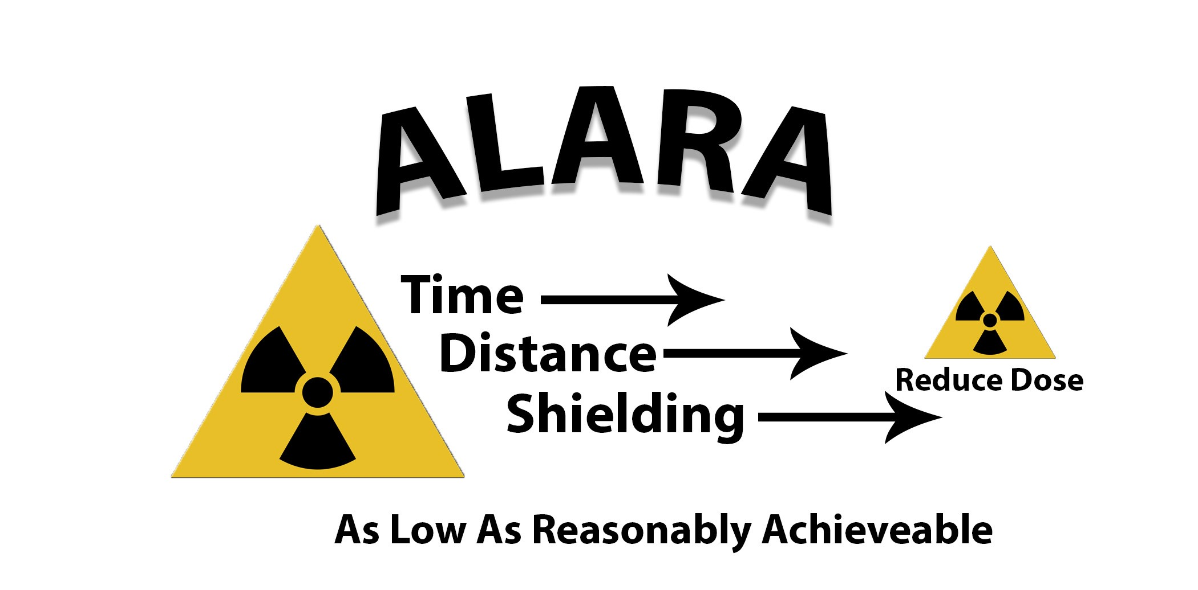

Ionizing Radiation and Cognitive Mortality Among Department of Energy Cohorts: Potential Risk and Role of Work Design Interventions
Tony Zbysinski, Andreas Neophytou, & John Rosecrance
Background
Methods
Results
Non-cancer risks associated with chronic and occupational low dose ionizing radiation (IR) include cataracts, decreased life span, and heart disease.
In exposed occupations principles of As Low As Reasonably Achievable (ALARA) are legally mandated and incorporated into all radiation protection programs in a constant effort to reduce IR exposure.
Work design and human factor interventions such as ALARA are key in radiation safety to reduce risk of adverse health outcomes, however, many such outcomes have been understudied and are of research interest to important stakeholders such as the Department of Energy (DOE), the National Aeronautics and Space Administration, the U.S. Navy, and others.
Combined DOE cohort data will be analyzed with Cox regression and Standardized Mortality Ratios for risk of neurocognitive related mortality.
Work design and human factors will be assessed through site visits to help conceptualize exposure assessment and to identify systematic weaknesses and best practices.
Finally, a retrospective counterfactual analysis will be conducted.
ALARA was implemented into federal law in 1974. Due to ALARA and other interventions, exposure has generally dropped considerably over the years.
Current literature that suggests a positive association with IR and cognitive outcomes is based on either high dose acute exposure or animal models.
In the presence of a positive association at low doses, the role of ALARA in exposure - and by extension - risk reduction will be explored.
Objectives
Conclusion
Proposed methodology aims to answer the question: does ionizing radiation exposure among DOE cohorts increase risk of neurocognitive mortality, what role has ALARA played in reducing exposure and risk, and how can ALARA be continuously refined to not only further reduce exposure but to also help workers accomplish tasks? An interdisciplinary approach will be employed to address these research gaps and continue to improve radiation worker health and safety.
The completed research will be the product of multi-disciplinary methods and show ALARA in a work design and human factors perspective. It will provide evidence in guiding future work design intervention. Such interventions can modify tasks to better fit the worker, reduce IR exposure and adverse health outcomes, potentially cognitive or musculoskeletal disease, so that workers can lead longer and healthier lives.

