Slide 1
Interfolio Annual Review Report
A How-to guide for SPA faculty

Slide 2
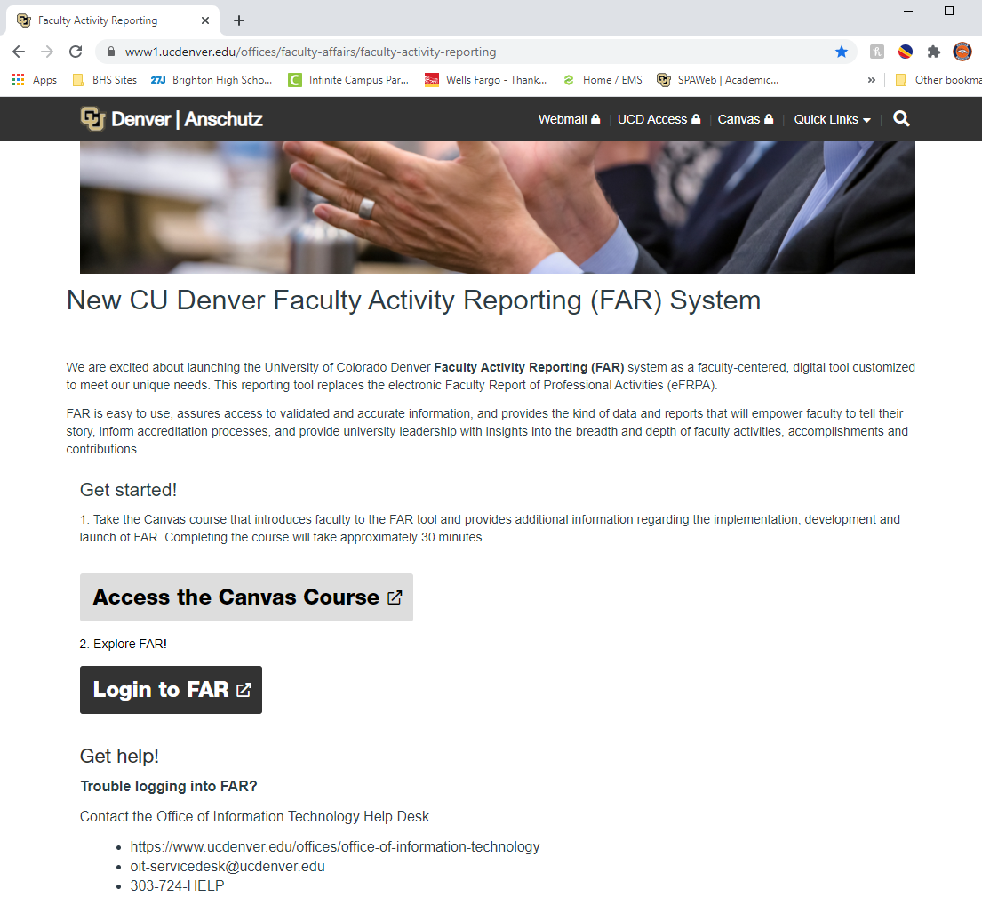
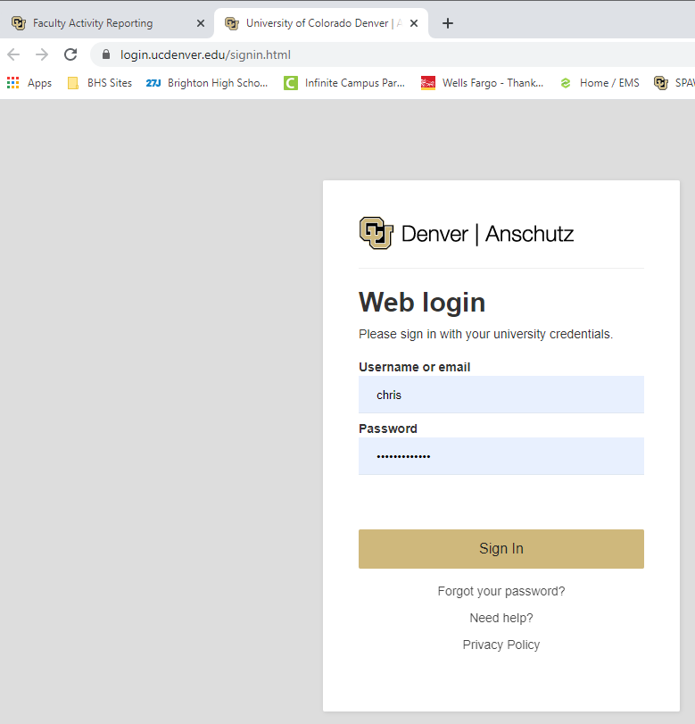
Logging In
Log into the FAR system:
https://www1.ucdenver.edu/offices/faculty-affairs/faculty-activity-reporting

Slide 3
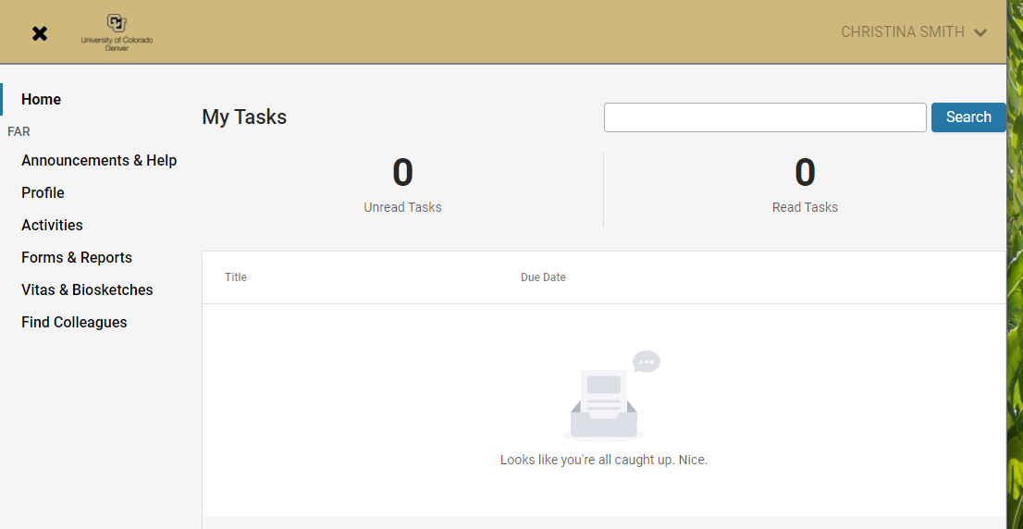
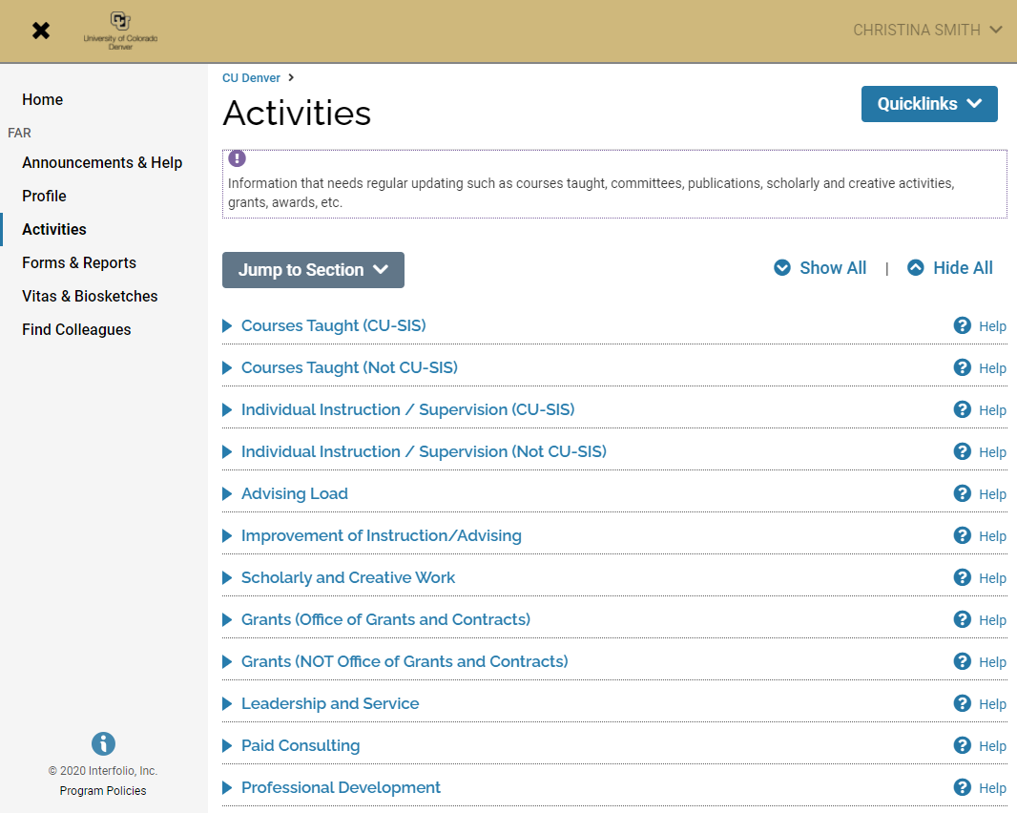
Reviewing, Editing, or Adding Activities
Click on ‘Activities’ and then then click on the ‘Jump to Section’ dropdown box to find the type of activity you want to enter. Enter all of your data here in its appropriate category.
All Publications and Scholarly Activities can be found by clicking here
Leadership & Service Activities are found here

Slide 4
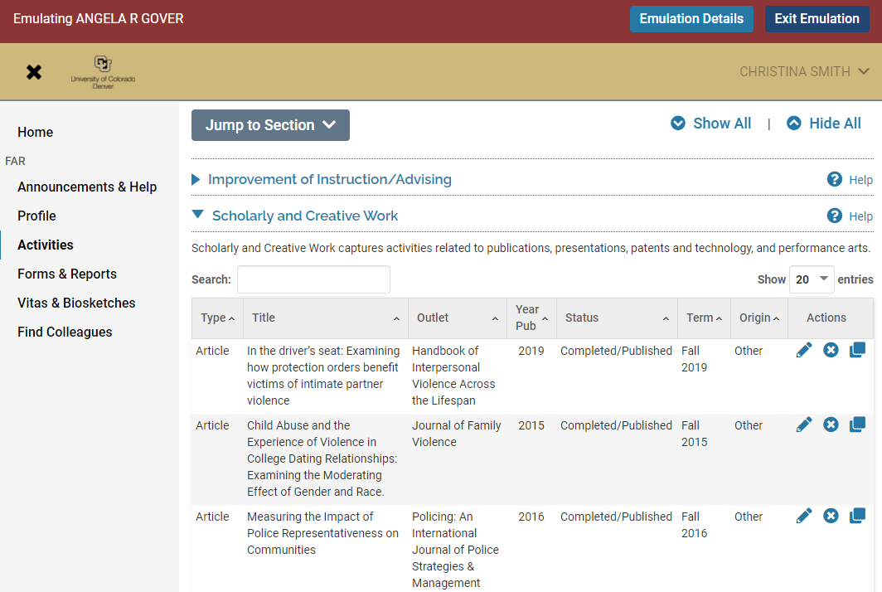
Status of Scholarly Activities
Scholarly activities can have a status of “in progress,” “submitted”, or “completed,” based on your previous e-FRPA reports. Go through all of your entries and be sure that everything is marked with the correct status. In Interfolio, you can mark publications with the following:
In Progress
Submitted
Revise & Resubmit
Accepted
In Press
Completed/Published
Work Discontinued
You do this by clicking the pencil icon to EDIT the entry

Slide 5
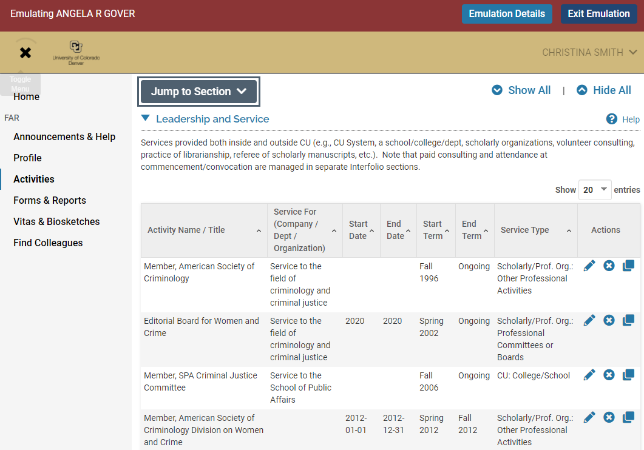
Editing Start/End Dates of Activities or Ongoing Activities
Entries of activities that are ongoing do not have to be re-entered each year. You just need to change the end term to “ongoing.” For example, you are probably on committees that are ongoing like the MPA committee or you may be on editorial board that are ongoing. Again, just EDIT the entry by clicking the pencil icon.

Slide 6
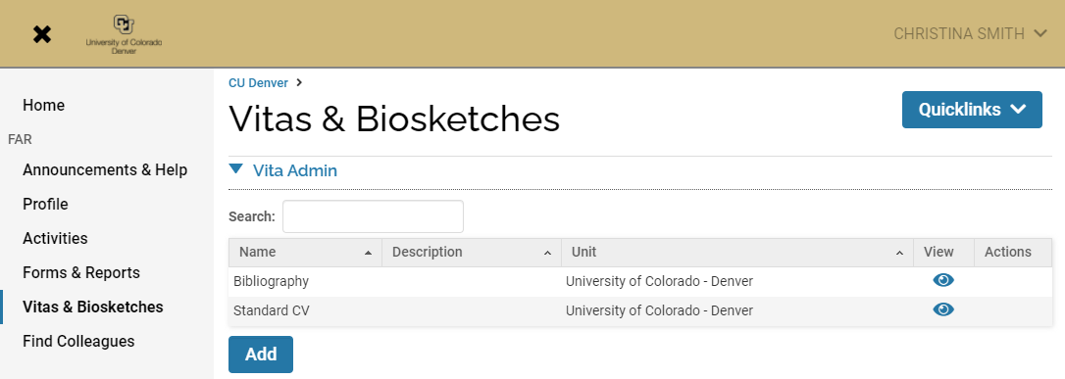
Producing a CV and/or Annual Review Report
To produce the annual review report, go to “Vitas & Biosketches”. Then click on the eyeball icon next to “Standard CV”

Slide 7
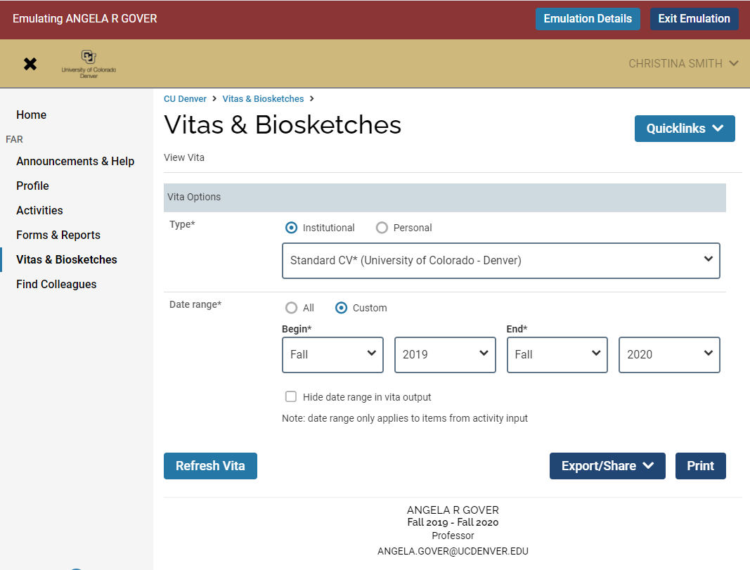
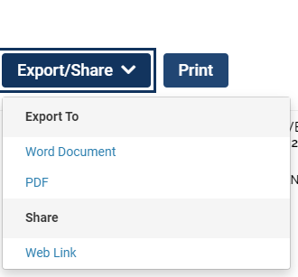
Producing a CV and/or Annual Review Report (cont’d)
NOTE- Interfolio automatically defaults to 2019 as the start date and will start producing the report automatically, let the process run, then after the report runs you need to change the start date to Spring 2020 and produce another report.
Change the start date to Spring 2020 and end date to Fall 2020 then press “Refresh Vita” to produce your 2020 annual report CV (previously known as the e-FRPA).
You can then scroll down to view the online version, but you must hit “Export/Share” to download it to Word and/or PDF to be submitted to the APC

Slide 8
Technical Support & Help
For further assistance, contact Chris.Smith@ucdenver.edu. She can help walk you through how to update or correct your data, how to produce reports, or any other issues with Interfolio. This can be done through a Zoom screen share meeting and/or you can assign Chris permission to “Emulate” you within your Interfolio profile so that she can make edits or run reports on your behalf. This permission can be assigned for a specified period of time that you enter, or it can be ongoing. This permission can also be rescinded at any time.
For information on how to assign “Emulate” access, please click on the link in the “How To” PDF to watch a short one-minute video.

