Slide 1
SAGE Junior Faculty Workshop - Teaching Research Methods and Statistics ACJS – Baltimore - 2019 Callie Marie Rennison, PhD University of Colorado Denver School of Public Affairs

Slide 2
Teaching Research Methods and Statistics
The most dreaded classes according to students (and some professors)
It doesn’t have to be, and shouldn’t be!
There are three overlapping approaches I take when teaching these classes:
Why Why Why Why Why? Tell them why for everything.
Make it relevant through examples (and failures) – many they gather.
Make it fun. This is possible.

Slide 3
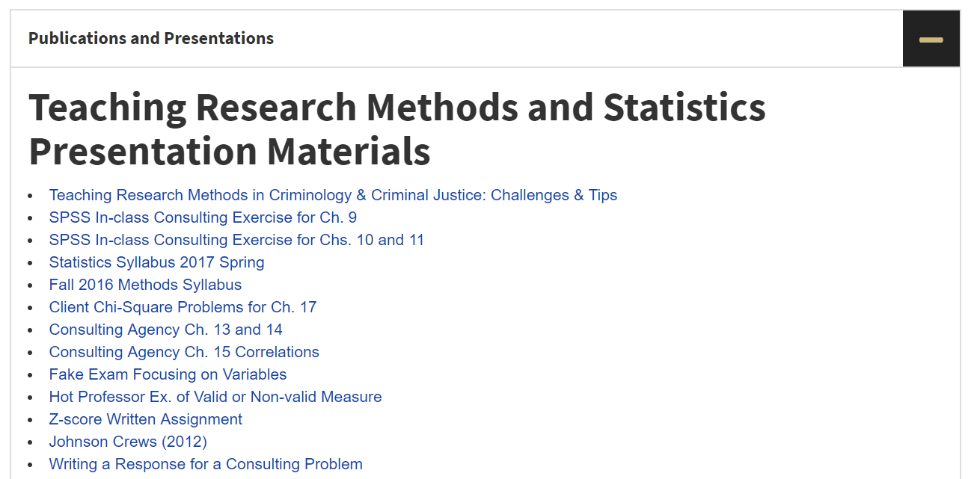
Resources Available Online
https://publicaffairs.ucdenver.edu/people/faculty-and-staff-directory/person-detail/callie-rennison-ucd7573
Scroll down to a section titled: “Publications and Presentations” and click on that to get the list of resources

Slide 4
1. Why Do RM/Stats Matter?

Slide 5
1. Why Do RM/Stats Matter?
Focusing on “Why” is critical.
Show what happens when research goes wrong.
Assists them in becoming a critical consumer
Why is this course important?
Why is this material important?
Why is this chapter important?
Why is this concept important?
Repeat the “why” frequently.

Slide 6
1. So, Why Do RM/Stats Matter?
Directly related to what we think we know and derived from it~
NVAWS vs NCVS – Violence against women estimates
FBI vs NCVS – crime? Up or down? (differ 3 of 5 years)
Koss vs. Krebs et al. vs NCWSV vs NCVS – Violence against college women: epidemic or not? Is campus crime out of control?
Which estimate is better? Which is right?
Wrong question to ask. Each is different.
Different samples, questions, definitions, modes
Given these differences in RM, differences in estimates are not surprising and even expected.
Tell them that they can make these distinctions themselves with the RM and statistics training these classes offers.
Students can get their own examples and share with the class why RM & Stats understanding are important.
Students can begin to see themselves as researchers.

Slide 7
2. Make RM/Stats Relevant

Slide 8
2. Making RM/Stats Relevant
We must show students how this material is used in important ways outside of class.
Focus on how these skills are used in the real world to solve real problems
Finding applied work is good for this and how they can apply it in the so-called real world (consulting/presentation – more on this later).
Using interesting examples of the concepts of interest
Have students locate examples and share them (see ‘fun’ assignments on the web)
Bad statistics examples; bad survey examples, bad survey questions
Show students how what they are learning can be added to their resumes, and that this can assist them in finding work.
Basic SPSS skills
Basic survey construction skills
Basic analytic skills
Basic GIS skills

Slide 9
2. Relevancy and Good Texts
Want accurate information on interesting topics/examples
Focuses on “why” and “relevance”
Reflect contemporary issues (e.g., mapping, college victimization, sex trafficking)
Reasonable costs
Texts with good ancillaries
I use:
Research Methods by Rennison and Hart
Damned Lies and Statistics by Joel Best
Statistics for the Behavioral Sciences by Privitera

Slide 10
Why Best’s Damned Lies and Statistics?
Designed for a general audience.
Eases students into the material with relevant examples.
Demonstrates the importance of RM and statistics and how they affect what we think we know.
Focuses on questions a critical consumer and creator of information should ask/consider:
Samples
Definitions
Measurement
Analyses, etc.
Small and inexpensive (~30$)

Slide 11
Worst Statistic Ever from Joel Best (available in online resources)
World's Worst Statistic: "Every year since 1950, the number of American Children gunned down in the U.S. has doubled.”
That's a lot of gunned down American Children!!
YEAR | NUMBER GUNNED |  | YEAR | NUMBER GUNNED |  | YEAR | NUMBER GUNNED
1950 | 1 |  | 1973 | 8,388,608 |  | 1996 | 70,368,744,177,664
1951 | 2 |  | 1974 | 16,777,216 |  | 1997 | 140,737,488,355,328
1952 | 4 |  | 1975 | 33,554,432 |  | 1998 | 281,474,976,710,656
1953 | 8 |  | 1976 | 67,108,864 |  | 1999 | 562,949,953,421,312
1954 | 16 |  | 1977 | 134,217,728 |  | 2000 | 1,125,899,906,842,620
1955 | 32 |  | 1978 | 268,435,456 |  | 2001 | 2,251,799,813,685,250
1956 | 64 |  | 1979 | 536,870,912 |  | 2002 | 4,503,599,627,370,500
1957 | 128 |  | 1980 | 1,073,741,824 |  | 2003 | 9,007,199,254,740,990
1958 | 256 |  | 1981 | 2,147,483,648 |  | 2004 | 18,014,398,509,482,000
1959 | 512 |  | 1982 | 4,294,967,296 |  | 2005 | 36,028,797,018,964,000
1960 | 1,024 |  | 1983 | 8,589,934,592 |  | 2006 | 72,057,594,037,927,900
1961 | 2,048 |  | 1984 | 17,179,869,184 |  | 2007 | 144,115,188,075,856,000
1962 | 4,096 |  | 1985 | 34,359,738,368 |  | 2008 | 288,230,376,151,712,000
1963 | 8,192 |  | 1986 | 68,719,476,736 |  | 2009 | 576,460,752,303,423,000
1964 | 16,384 |  | 1987 | 137,438,953,472 |  | 2010 | 1,152,921,504,606,850,000
1965 | 32,768 |  | 1988 | 274,877,906,944 |  | 2011 | 2,305,843,009,213,690,000
1966 | 65,536 |  | 1989 | 549,755,813,888 |  | 2012 | 4,611,686,018,427,390,000
1967 | 131,072 |  | 1990 | 1,099,511,627,776 |  | 2013 | 9,223,372,036,854,780,000
1968 | 262,144 |  | 1991 | 2,199,023,255,552 |  | 2014 | 18,446,744,073,709,600,000
1969 | 524,288 |  | 1992 | 4,398,046,511,104 |  | 2015 | 36,893,488,147,419,100,000
1970 | 1,048,576 |  | 1993 | 8,796,093,022,208 |  | 2016 | 73,786,976,294,838,200,000
1971 | 2,097,152 |  | 1994 | 17,592,186,044,416 |  | 2017 | 147,573,952,589,676,000,000
1972 | 4,194,304 |  | 1995 | 35,184,372,088,832 |  | 2018 | 295,147,905,179,353,000,000
* 1965, 9,960 homicides in the U.S. according to the FBI SHR
* The 1980 estimate is more than four times the population in the U.S. at that time.
* The estimate in 1983 is over two times the earth's population at that time.
* The estimate in 1987 surpasses the estimate of the number of human being who have ever lived. Ever.
What is this number anyway?

Slide 12
Why Rennison and Hart?
This book was written with the things I’m talking about today in mind (with Tim Hart).
Contemporary and focuses on critical skills
how to develop a research question
Chapter on writing a literature review
Chapter on making research policy relevant
Chapter on using these skills to start a career
Shows researchers as approachable humans and encourages students to see themselves as researchers.
Online resources that students appreciate and that make our lives easier.
Cost is reasonable, and the book weighs little – tired of books that weigh as much as a Buick.

Slide 13
Why Privitera?
Clear
Uses language that students can easily understand with minimizes the amount of emotional first aid required in all stats courses.
Accurate
Many books are not accurate (e.g., key), and there is nothing worse than dealing with normal student anxiety PLUS errors in the text.
Offers examples throughout the Social Sciences
Shows students these skills go beyond criminology and criminal justice – real world issues.
Online resources***
Even students comment on how useful they are
Reasonable cost and weight

Slide 14
3. Making it Fun, aka Effective Teaching & Engaged Students

Slide 15
3. Making it Fun
Give lots of examples of the use of these skills in areas they can relate to (see fun journal articles provided).
Rate my professor
Police impersonation
Give examples of what happens when the topic of the chapter, and a concept is conducted/used poorly. Demonstrating failure is fun and important.
Helpful to describe your own failures when conducting research. Humanizes research.

Slide 16
3. Making it Fun
Simplify the language/ Translate jargon to English
I tell students that RM and statistics are language classes, not math classes.
Translate ‘statisticese’ to ‘English’. For example, “standard” = “average”; “deviation”=“distance.”
Clearly identify why we use a particular technique/ approach, and why are others inappropriate.
It is not enough to just say to use a technique for X situation, you must say specifically why we use it and how it differs from other techniques that seem the same, and why it matters. What happens when you do it wrong?
Types of samples
Survey question wording
Response categories
OLS vs Logistic regression

Slide 17
3. Making it Fun
Students do not want to just read book, listen to us lecture, and write papers.
Students *should* do these things, but we have to do much more to make this fun which engages them and assists in their learning.
Effective approaches I use:
Consulting businesses
Presentations of findings at class conference panels. I am “that person” at the conference that is always asking “those questions”.
Fake quizzes
In class group work
Fun and relevant journal articles
**Note that when using these approaches plus traditional approaches, students learn the material via reading, listening, writing and speaking – not just one mode.

Slide 18
3. Making it Fun – Consulting Businesses (see documents available online)
Students don’t learn about the material – they USE the material.
Students are required to develop a consulting business (i.e., name) and title for themselves (e.g., President or CEO)
Written assignments have fake clients approaching the consulting agencies to answer important Research Methods and Statistics issues.
Papers due are required to be professional reports – deliverables - for the client (which I grade).
Examples include identifying bad statistics, accessing reports from BJS, NIJ, CDC, identifying unethical research, defining concepts, creating a survey.
Increases student engagement and teaches them to write about RM/Stats for any audience

Slide 19
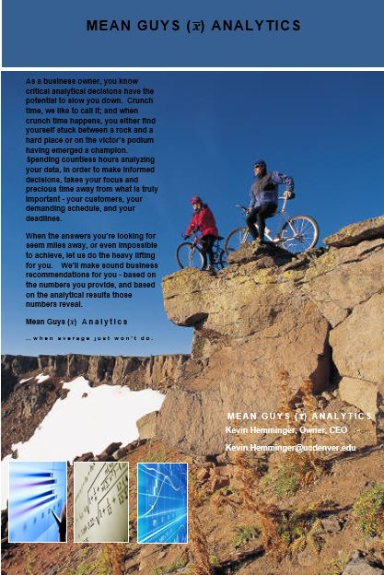
Consulting Marketing Materials

Slide 20
Example of Consulting Assignment (see documents available online)
Report #3: The non-profit “Ethics are Us!” recently received a large donation ear-marked for identifying and shaming those conducting unethical research in the community.
Your agency’s reputation is one of performing excellent work so they have entrusted you with this task. Your job is to find an instance of unethical research. Because Ethics are Us! is not a criminological based agency, it is okay if the example you select is not criminological in nature.
Once you have found an example, please write a professional consulting report for the client with the following:
An introduction about what you are doing and why it is important.
A summary of the unethical research – purpose, methodology and findings.
Describe specifically why you believe the work is unethical – use information from your text and lecture.
Address whether you believe the research question posed may have been researched in another more ethical way. If so, how?
Address also if you believe that what was learned outweighed the ethical problems with this research.

Slide 21
Making it Fun – Class Conference Presentations
In class, Consulting Agency leaders are required to present their important findings.
Context is that we are on a panel at a professional conference.
Students learn to introduce themselves, welcome the attendees and thank them for coming (important general skills).
I am “that person” in the panel audience (you know who I’m talking about!) that asks annoying questions such as “why did you do that?” “who cares about this?” “everyone knows what ‘stalking’ means” “what would you do differently if you had more money or time?”
Students learn to think on their feet and to handle questions professionally.
It also identifies holes in their understanding which can be addressed on the spot – they can try the answer again.
Presentations conclude with audience questions and applause.

Slide 22
Making it Fun – Fake Quizzes (see documents available online)
Use for material that students struggle with but will not ask questions about. Great examples focus on validity, independent and dependent variables, etc.
Students take a quiz. I then go over the answer and students grade their own work.
I find that this approach forces them to recognize weaknesses in their understanding of the material, and makes them more inclined to ask questions. Reduces soul-crushing at exam time.
Question Examples:
9. In research interested in the role that marital status has on offending behavior, which of the following is the dependent variable?
a. marital status
b. offending behavior
c. both marital status and offending behavior
d. neither marital status and offending behavior are the dependent variable
10. Benoit and Kennedy (1992) performed a study of 100 adolescent males incarcerated in Florida. This study examined the relationship between prior sexual and physical abuse in the respondent’s childhoods and the type of offense for which they were convicted. What is the independent variable and the dependent variable for this study?
a. previous criminal behavior; current sentence length.
b. previous childhood abuse; the type of offense committed.
c. the type of offense committed; previous childhood abuse.
d. all of the above

Slide 23
Making it Fun – In-Class Group Work (see documents available online)
For some classes during the semester I engage students and enhance learning through in-class group-work.
As a baby boomer, I personally don’t get it, but it is clear that when students work together, they can really grasp the course material and enjoy the activities.
Student groups are required to report their findings to the class – again in conference presentation style
Examples include:
Field research activity
Secondary data analysis

Slide 24
Example of In-Class Secondary Data Analysis
The World Bank offers numerous resources that are useful for comparative research. In this option, please go to the
World Bank Web site at www.worldbank.org. Here you will find all sorts of data and statistics listed by countries.
Please select a random sample of 5 countries along with 3 social indicators of your choice. From the information provided, summarize the differences and similarities you have identified between the five countries.
Groups are to report out on….(see online document).
Other examples include:
Statistics/estimates on CCJ topics from BJS
Social indicators on countries from the World Bank
Economic indicators from Bureau of Labor Statistics
Indicators on cities in the US from city-data.com

Slide 25
Making it Fun – Fun & Relevant Journal Articles (see documents available online)
Many students view research journal articles as dry and boring.
Find some fun ones that offer examples of topics of interest.
With fun articles, students more easily learn the structure of articles (i.e., introduction, lit review, methods, findings…)
Plus, they can see that not all research seems dull and boring.
I use:
CORRELATIONS: Johnson & Crews (2012). My professor is hot! Correlates of RateMyProfessors.com ratings for criminal justice and criminology faculty members, American Journal of Criminal Justice, 38, 639-656.
CONTENT ANALYSIS: Cobbina, J. (2008). Race and class differences in print media portrayals of crack cocaine and methamphetamine. Journal of Criminal Justice and Popular Culture, 15(2), 145-168.
SECONDARY DATA: Rennison, C & Dodge, M. (2012). Police impersonation: Pretenses and Predators. American Journal of Criminal Justice, 37(4), 505-202.

Slide 26
Making it Fun – You
There is no substitute for a professor who loves this the topic. This will be apparent and contagious. Don’t hold back!
If you don’t love research and statistics, if you don’t believe it is important for them to learn and use, you will never convince students differently.

Slide 27
Conclusion
Initially, there may be some groans about these approaches from a crabby few, but almost immediately all students really get into it!
Using these techniques means you will enjoy teaching & grading this material more as well.
I find that we all end up having a great time – and the students learn the material.
Students love becoming critical consumers – and in fact I always have to reel them in and tell them that aside from being a critical consumer, they need to ask themselves “how would I do this better?”
Even the research papers/surveys/consulting reports become a source of great interest. By the end, I have to remind them of the limitations of the work they’ve done (they have dreams of publication)
Students correspond post-graduation that they really use these skills in ‘real life’!

Slide 28
Questions?

